Slide 1
Anaphylaxis &
Epinephrine Administration for the EMT
Indiana Department of Homeland Security
EMS Division
Topic | Sub-Topic | EMT | AEMT | NRP
Medical | Medication Delivery | - | - | 1
 | Immune Disease | 1 | 1 | -

Slide 2
Learning Objectives:
With successful completion of this training module, the EMT will be able to describe and/or correctly demonstrate …
Epinephrine identification as a medication
Signs and symptoms of anaphylaxis
The mechanism of action and effects of Epinephrine
Steps in aseptic technique
Preparation of Epinephrine for administration
Intramuscular administration of Epinephrine

Slide 3
Key Terms
Anaphylaxis - a life-threatening, hypersensitivity reaction of the immune system
Aseptic technique - a procedure performed under sterile conditions
Asphyxia - suffocation as a result of blockage of the airway
Dyspnea - labored or difficult breathing
Epinephrine - a hormone released from the adrenal glands that activates several tissues in the “fight-or-flight” response
Histamine - one of several chemical messages released from immune cells that promote inflammation as a defense mechanism
Intramuscular - a medication route by injection into the belly of a muscle which encourages rapid transport in the bloodstream
Shock - a severe reduction in blood pressure (by any cause) that results in inadequate blood flow (oxygen & glucose) to tissues

Slide 4
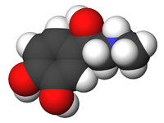
What is Epinephrine
A synthetic form of the naturally occurring hormone Epinephrine
Released during “fight or flight” responses
  reflex stimulation of the adrenal gland
  sympathetic division of the autonomic nervous system

Slide 5
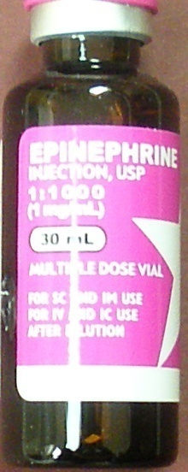
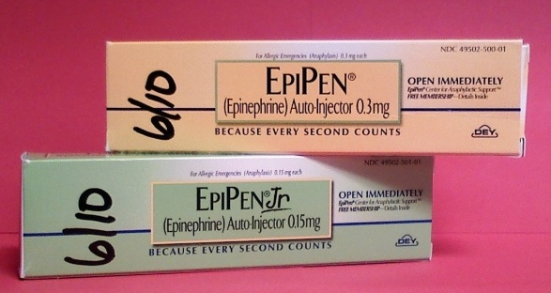
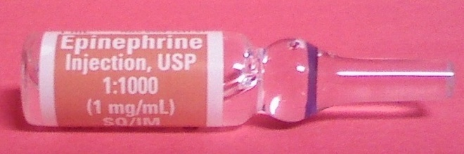
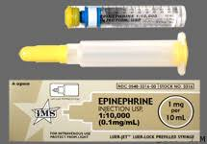
Examples of the Medication
Always be sure to check the
  Name of medication
  Concentration (1:1,000 or 1mg/1ml)
  Expiration date
  Note that cardiac epinephrine is NOT the same formulation/concentration as that used for anaphylaxis and cannot be used.

Slide 6
Indications for Use
EMTs may administer Epinephrine for:
Anaphylaxis
Anaphylactic shock
Dosage:
Adults - 0.30 mg of 1:1,000
Pediatrics - 0.15 mg of 1:1,000
Is this a different dose than when using the Epi-pen?
>30kg
(66 lbs)
<30kg
(66 lbs)

Slide 7
Anaphylaxis & Your Immune System
Anaphylaxis is an over-reaction of the Immune System
  Sudden, severe allergic reaction involving the whole body (more than a local reaction)
  Most common allergens= insect stings, food, medication, latex
  Widespread immune system responses cause itching, hives & swelling
  May also cause tachycardia, hypotension, and hypoperfusion
  Tracheal and bronchial swelling may result in asphyxia

Slide 8
Signs and Symptoms of Anaphylaxis
Shortness of breath
Hoarseness, wheezing, or other abnormal sounds of breathing
Hives, itching, swelling and/or spasm
Rapid and/or labored breathing, use of accessory muscles, prolonged expirations, hypoventilation, decreased lung sounds
Changes in the ability to speak
Vomiting and diarrhea
Swelling of the lips, tongue, throat
Low blood pressure, flushing, fainting
Skin rash may or may not be present

Slide 9

Signs and Symptoms of Anaphylaxis
https://commons.wikimedia.org/wiki/File:Signs_and_symptoms_of_anaphylaxis.svg

Slide 10

Action of Epinephrine
Relaxes smooth muscle in the airways
Counteracts histamine and other cytokines
Raises blood sugar level
Raises heart rate, blood pressure, and myocardial oxygen demand
For Intramuscular injection of Epinephrine…
Onset of effect: 3-5 min
Duration of effect: 1-4 hours

Slide 11
Side Effects of Epinephrine
Palpitations
Tachycardia & dysrhythmias
Hypertension
Headache
Tremor, weakness
Skin signs: pallor, sweating
Nausea & vomiting
Nervousness & anxiety
Pain, redness at the injection site

Slide 12

Six Rights of Drug Administration
Right person
Right drug
Right dose
Right time
Right route
Right documentation

Slide 13
Site Selection and Preparation
Site Selection
  Intramuscular sites allow a drug to be injected into the belly of a muscle so that the blood vessels supplying that muscle distribute the medication to its site of action via the bloodstream.
Preparation
  Prep the site with approved antiseptic by scrubbing vigorously and allowing to dry. DO NOT TOUCH, BLOW ON OR FAN THE INJECTION SITE!
  Align the syringe and needle above the injection site at a 90 degree angle (to help insure IM administration of drug).

Slide 14
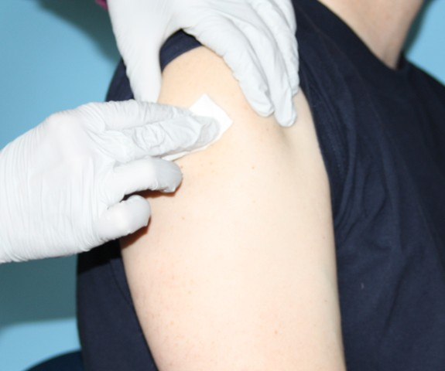
Prepare the site
Scrub the skin vigorously with an alcohol wipe
Allow to air dry (do not touch, blow on, or fan the injection site)
Isopropyl alcohol aids the removal of bacteria from the skin surface, it does not kill bacteria.

Slide 15
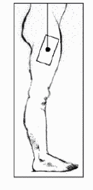
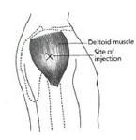
Intramuscular Injection Sites
Preferred
Site!!
Deltoid Muscle
Anterolateral Thigh

Slide 16
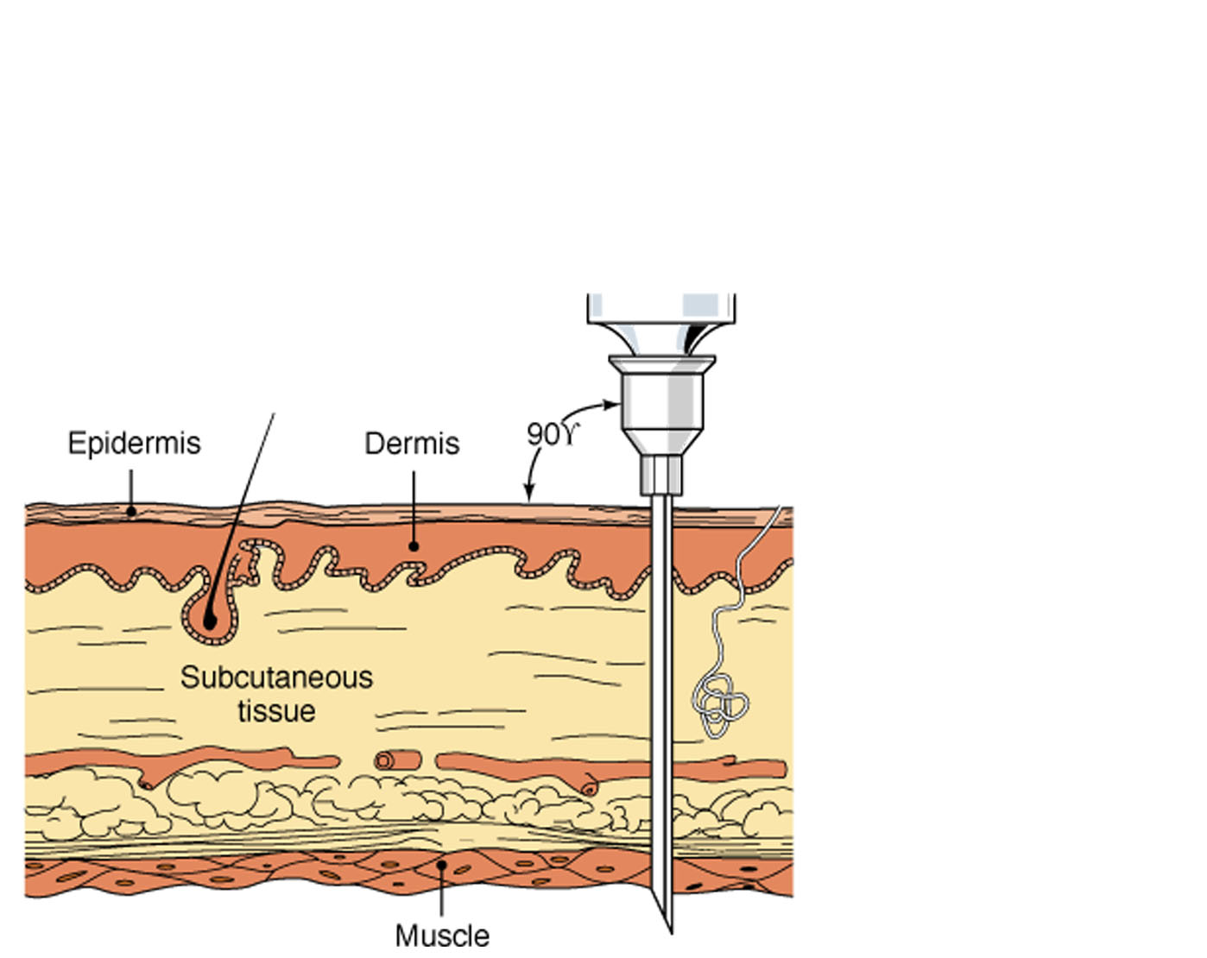
Intramuscular Injection
90º

Slide 17
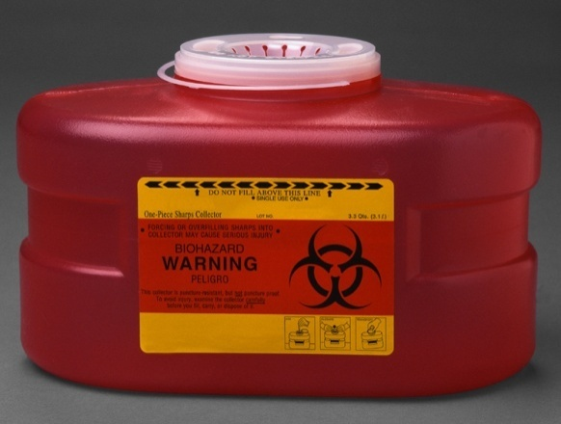
Needle Handling Precautions
Minimize the tasks performed in a moving ambulance.
Immediately dispose of used sharps in a sharps container.
NEVER recap needles

Slide 18
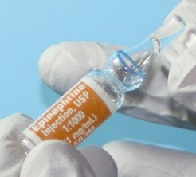

Ampules and Vials
Store epinephrine AWAY from light; leave it in its carton until ready to use. Also keep away from extreme heat and danger of freezing.
Ampule
Multi-dose Vial
Self-sealing rubber top
top
scored neck

Slide 19
Documentation
Treat & Document all information concerning the patient and medication, including:
  ABC’s; high-flow oxygen therapy via NRB
  Indication for drug administration
  Vital signs, work of breathing, lung sounds, skin signs, and ability to speak
  Drug, dosage, and delivery site
  Patient response to the medication
  Vital signs, work of breathing, lung sounds, skin signs, and changes in ability to speak
  Both positive and negative responses

Slide 20
Skills Section:
Obtaining Medication from a Glass Ampule

Slide 21
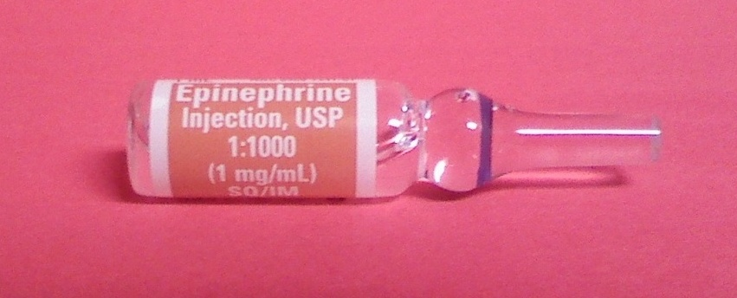
Confirm the Medication
Medication name
Dosage (1:1,000 or 1mg/1ml)
Expiration date
Not cloudy; no color or precipitate

Slide 22
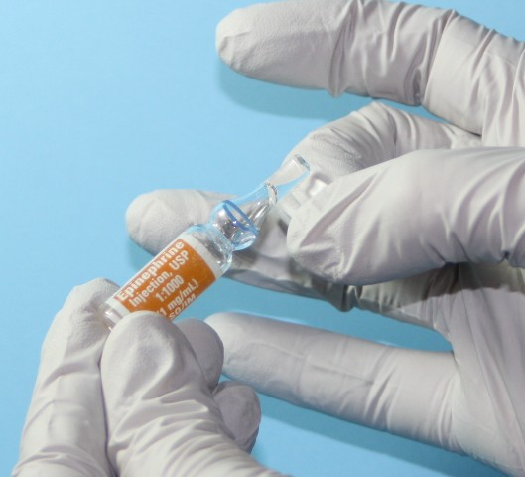
Hold the ampule upright and tap its top to dislodge any trapped solution.

Slide 23
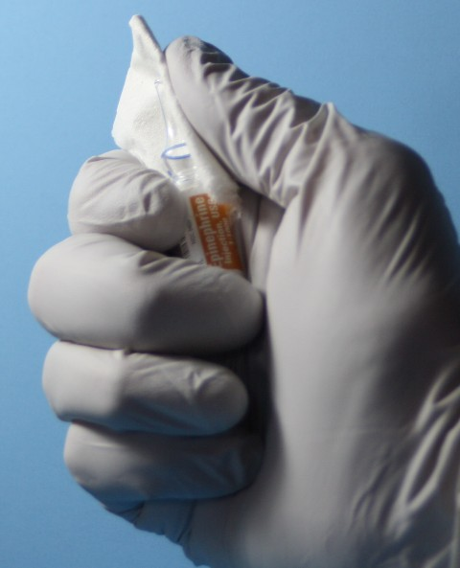
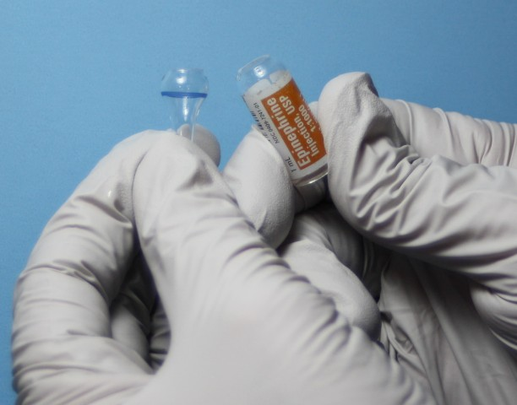
Use thumb to break along scored edge of ample.
You may place gauze around the neck to prevent the sharp edge of the glass from cutting your thumb.

Slide 24
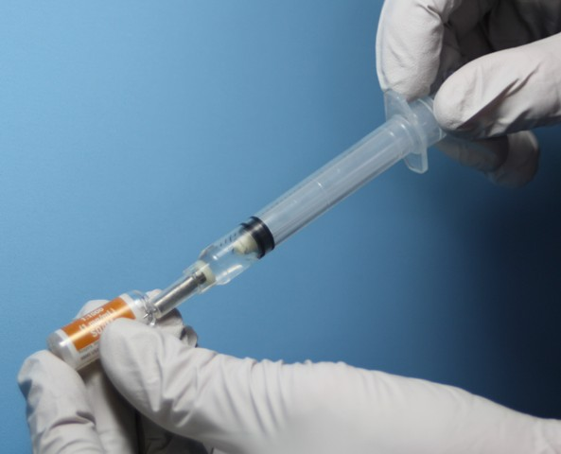
Draw up the medication
Note that filter needles may be used if available, but should NOT delay administration in the event of an emergency.
Using a syringe, insert the needle into the ampule and draw the plunger back until you reach the correct dosage
(PEDS = 0.15 cc or ADULT = 0.30cc)

Slide 25
Skills Section:
Obtaining Medication from a Vial

Slide 26
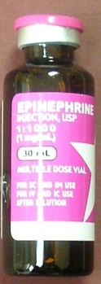
Confirm the Medication
Medication name
Dosage (1:1,000 or 1mg/1ml)
Expiration date
Not cloudy; no color or precipitate
Always check the dose and the concentration on the vial as some vials are multi-dose vials.

Slide 27
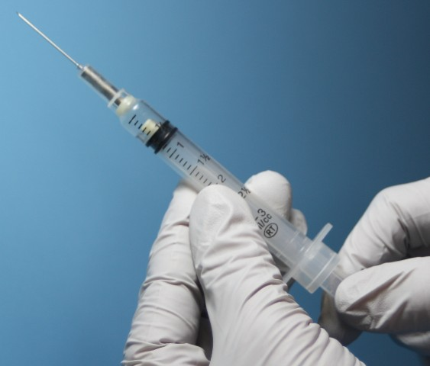
Prepare the syringe
With the needle cap on, pull back the plunger to the appropriate dosage. You will inject the same volume of air into a multi-use vial as you will withdraw medicine.

Slide 28
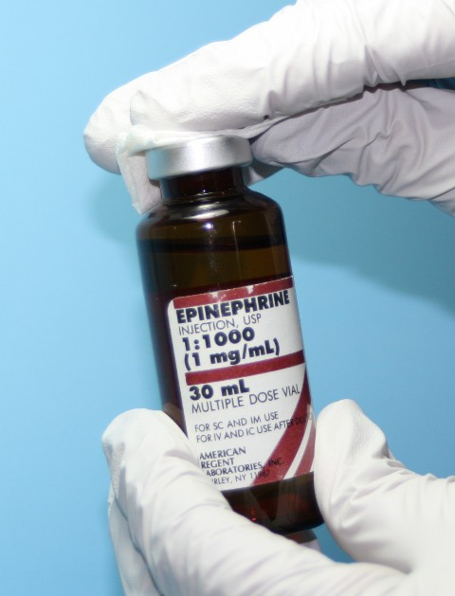
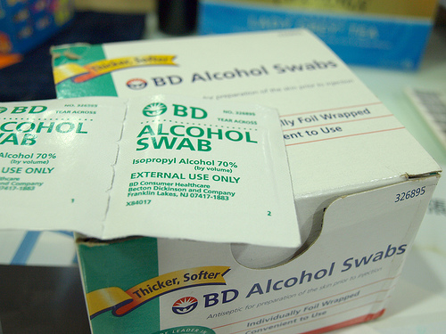
Clean the vial’s rubber top

Slide 29
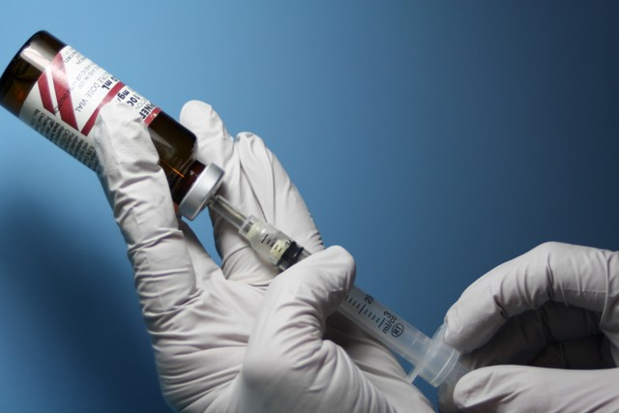
Insert the needle into the rubber top and inject the air from the syringe into the vial.
Withdraw the appropriate volume
of medication. Do not fill with more than the correct dosage.

Slide 30
Skills Section:
Intramuscular Injection

Slide 31
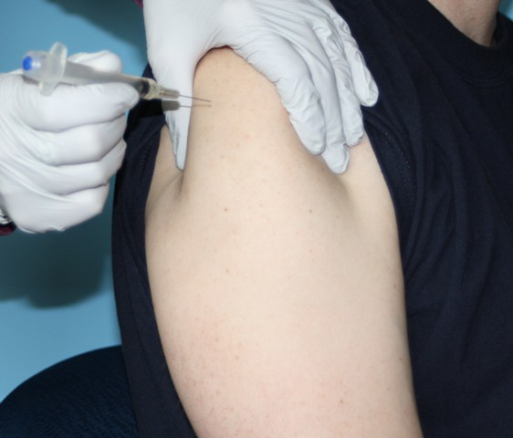
Insert the needle at a 90-degree angle
Broadly hold the muscle
Do not pinch the skin
Hold the syringe like a dart
Insert the needle with a quick stab at a 90° angle to the skin surface

Slide 32
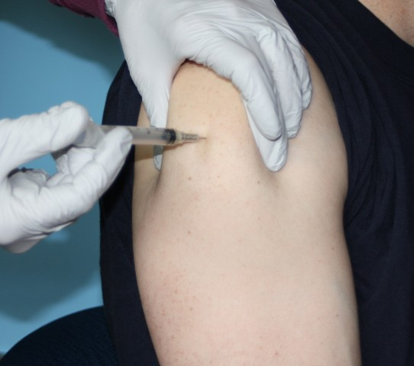
Deliver the medication
Draw back slightly on the plunger to verify you are not in a blood vessel
Depress the plunger with a slow, steady motion until the syringe is empty and all of the medication is delivered

Slide 33
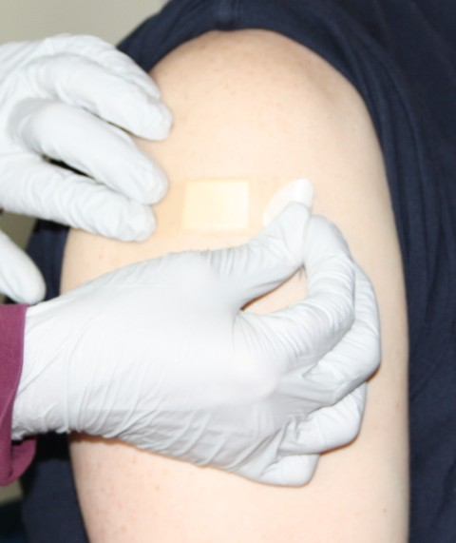
Dress the Site
Cover the puncture site.
Reassess your patient.
Prepare for transport by ALS if available.

Slide 34
Assessment of Patient Response
Document the patient’s response to treatment:
  LOC, behavior, breathing effort, lung sounds, skin signs, vital signs, and changes in ability to speak
  Document adverse effects if any occurred

Slide 35
Document Vital Signs before and after treatment with Epinephrine
Because epinephrine is expected to cause widespread changes in function, it is important to frequently monitor and document vital signs:
  HR, RR, BP
      Include general appearance, work of breathing, lung sounds, skin signs, and ability to speak

Slide 36
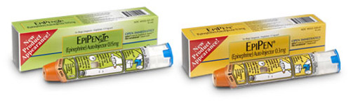
Epi-Pen Brand Dosages
Pediatrics - 0.15 mg of 1:1,000
Adults - 0.30 mg of 1:1,000
The same dosage schedule is used in anaphylaxis, no matter the method of IM administration.

Slide 37

Always wear PPE when treating patients
Wear gloves and goggles when assessing the patient, preparing the medication, cleaning the site of injection, and administering the drug.

Slide 38
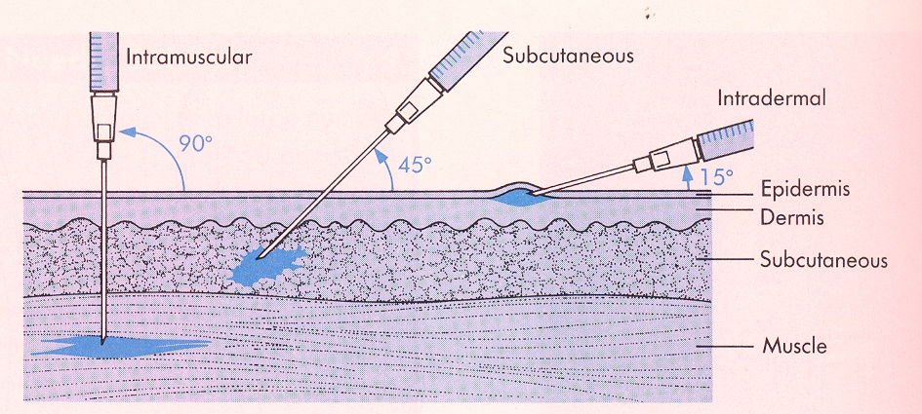
Be sure to inject Epinephrine into the muscle
It may take twice as long (up to 10 min) for epinephrine to have it’s life-saving effect if not injected into the muscle.

Slide 39
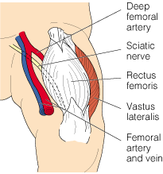
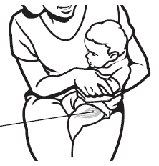
The anterolateral thigh is the best site for IM injection!
Good site for all ages, but esp. under 3 years old
Far from major blood vessels & nerves
Insert needle at 90° angle

Slide 40
Ongoing Assessment
If no significant improvement within 10 minutes, consider second dose
Second dose would likely requires consultation with online medical control
If unable to contact medical control or ALS unit, EMT may administer a second dose if patient’s condition warrants
Thorough documentation is essential
Follow your local protocol

Slide 41
Summary
Epinephrine is life saving for anaphylaxis.
  Pediatrics - 0.15 mg of 1:1,000
  Adults - 0.30 mg of 1:1,000
Epinephrine is safe when administered correctly.
IM injection is a safe and effective method of medication administration.
  Anterolateral thigh is the preferred site.
New legislation will allow EMT IM administration of epinephrine when clinically indicated for anaphylaxis.

Slide 42
References
Adapted from the Pilot Project for the Administration of Epinephrine by Washington State EMTs

