Slide 1


Connecting & Engaging.
It’s What We Do!
Adult Education and Workforce Development Statewide Webinar
March 11, 2020
Marilyn Pitzulo | Adult Education Staff
Department of Workforce Development | Indiana ADULT EDUCATION
10 N. Senate Avenue, IGCS SE 203 | Indianapolis, IN 46204
AdultEd@dwd.in.gov

Slide 2


Indiana ADULT EDUCATION
Basic Skills. High School Equivalency. Short-term Training. Certifications and More.
NEVER TOO OLD TO LEARN
“Did you see when they handed her the actual diploma?” her granddaughter asked. “And she realized it’s really a diploma? I think that’s when it really hit her.”
Lucille (Baker) Rudolph accepted an HSE honorary diploma with a misty-eyed smile.
For a moment it didn’t seem real for the 100-year-old Hoosier and resident of Northwood Retirement Community in Jasper.
Story by Allen Laman
Photo by Kayla Renie
The Dubois County Herald

Slide 3

Indiana ADULT EDUCATION
Basic Skills. High School Equivalency. Short-term Training. Certifications and More.
High school was a lifetime ago for the (resident of southern Indiana). But learning has never stopped.
Last month, in front of family and other guests, Lucille received an honorary high school equivalency from Vincennes University. She is the only person to ever be named an honorary high
school graduate of the university.
Lucille attended Alfordsville High School for two years beginning in 1933. Official handwritten transcripts show her efforts in algebra, biology, music, English, Latin, and a variety of other classes.
Story by Allen Laman
Photo by Kayla Renie
The Dubois County Herald

Slide 4
Indiana ADULT EDUCATION
Basic Skills. High School Equivalency. Short-term Training. Certifications and More.
Her memories from those days are fading. While earning a diploma had remained a dream for decades, she stressed that her knowledge never stopped growing when she left the classroom.
When Lucille was 16, she met her future husband, Gwen Rudolph. They both worked at a tomato canning factory,
caught each other’s eyes, and dated for two years before tying the knot.
They were married for 75 years that were filled with love, hard work and travel. Lucille has memories of helping Gwen – who many knew as Rudy – on the family’s Dubois County farm in Boone Township, near Pike County.
Story by Allen Laman
Photo by Kayla Renie
The Dubois County Herald

Slide 5
Indiana ADULT EDUCATION
Basic Skills. High School Equivalency. Short-term Training. Certifications and More.
NEVER TOO OLD TO LEARN
The funny and thoughtful (lady) keeps a sharp mind. She loves reading books and the newspaper, working out word scramble puzzles, going to Bible study, and talking to loved ones on the phone.
She is also an avid painter – a selection of her charmingly brushed canvases hung around the Northwood lobby that she proceeded through on her way to receiving the diploma.
“She’s a lifelong learner, she’s worked hard, she’s raised a great family,” Lauren Bell, director of adult education at VU, said.
“And we like to see dreams come true. And that’s what we do in our business. Help people achieve their dreams.”
“Live your life each day as you would climb a mountain.”
Harold B. Melchart
Story by Allen Laman
The Dubois County Herald

Slide 6
NRS State Table 4 – 2019-2020 3.6.2020

Slide 7
Indiana ADULT EDUCATION
Basic Skills. High School Equivalency. Short-term Training. Certifications and More.
8-Month Report
Off to
a FAST Start
2019-2020
INDIANA | NRS Table 4
Data March 2020 | 2019
Outcome | 2019-2020* | 2018-2019** | Difference
Enrollment | 19,724 | 18,882 | +842
MSGs | 57.02% | 51.35% | +5.67 pts.
HSEs | 3,105 | 2,131 | +974
*3.6.20 | **3.8.19

Slide 8
Indiana ADULT EDUCATION
Basic Skills. High School Equivalency. Short-term Training. Certifications and More.
8-Month Report
Off to
a FAST Start
Regional Data
MSGs | NRS Table 4
3.6.2020
1. DOC | 71.72% | 7. Region 5 | 53.28%
2. Region 9 | 67.81% | 8. Region 7 | 52.64%
3. Region 10 | 65.32% | 9. Region 3 | 50.68%
4. Region 8 | 61.37% | 10. Region 2 | 49.28%
5. Region 11 | 58.55% | 11. Region 6 | 49.18%
6. Region 1 | 57.70% | 12. Region 4 | 48.95%
MEASURABLE SKILL GAINS – State Average 57.02%

Slide 9
Indiana ADULT EDUCATION
Basic Skills. High School Equivalency. Short-term Training. Certifications and More.
8-Month Report
Off to
a FAST Start
Regional Data
Enrollments | NRS Table 4
3.6-2020
1. Region 5 | 6,269 | 7. Region 9 | 1,075
2. DOC | 3,112 | 8. Region 8 | 950
3. Region 2 | 1,674 | 9. Region 6 | 858
4. Region 3 | 1,620 | 10. Region 11 | 825
5. Region 4 | 1,385 | 11. Region 7 | 530
6. Region 1 | 1,104 | 12. Region 10 | 372
ENROLLMENTS – Total 19,724

Slide 10
Indiana ADULT EDUCATION
Basic Skills. High School Equivalency. Short-term Training. Certifications and More.
8-Month Report
Off to
a FAST Start
Regional Data
HSEs | NRS Table 4
3.6.-2020
1. Region 5 | 663 | 7. Region 11 | 187
2. DOC | 600 | 8. Region 2 | 187
3. Region 3 | 305 | 9. Region 4 | 179
4. Region 8 | 249 | 10. Region 9 | 146
5. Region 6 | 210 | 11. Region 7 | 110
6. Region 1 | 213 | 12. Region 10 | 67
High School Diplomas | Equivalencies

Slide 11

Indiana ADULT EDUCATION
Basic Skills. High School Equivalency. Short-term Training. Certifications and More.
8-Month Report
Off to
a FAST Start
Statewide Data
Up 711 from previous program year
Pass rate up 3.09 percentage points from previous program year
Biggest jump Math – 3.51 percentage points
7.1.19 - 1.10.20 | Pass Rate
3,104 | 78.96%
7.1.18 - 2.10.19 | Pass Rate
2,393 | 75.87
High School Diplomas | Equivalencies

Slide 12
Indiana ADULT EDUCATION
Basic Skills. High School Equivalency. Short-term Training. Certifications and More.
8-Month Report
Off to
a FAST Start
Statewide Data
Separation Rate
3.6.20
16.19%
3.8.19
18.24%

Slide 13
Indiana ADULT EDUCATION
Basic Skills. High School Equivalency. Short-term Training. Certifications and More.
8-Month Report
Off to
a FAST Start
Statewide Data
Reportable Individuals
3.6.20
5,111
Students with < 12 hours

Slide 14
Indiana ADULT EDUCATION
Basic Skills. High School Equivalency. Short-term Training. Certifications and More.
8-Month Report
Off to
a FAST Start
Statewide Data
Employment
Status at Entry
37% Employed 7,370
39% Unemployed 7,749
23% Not in the Labor Force 4,591
36% High School Credential or Higher

Slide 15
Indiana ADULT EDUCATION
Basic Skills. High School Equivalency. Short-term Training. Certifications and More.
8-Month Year Report
Measurable Skill Gains
63.81%
+ 6.46%
High School Equivalencies
956
14.39%
INDIANA
Distance Education
NRS Table 4C
3.6.2020
Number of Participants
6,642
33.67%

Slide 16

Trade Adjustment
Assistance (TAA)
Overview
Mandy Mahurin
TAA Unit - Operations Manager
Department of Workforce Development
8 NE 21st Street
Washington, IN 47501
812.881.9514
mmahurin@dwd.in.gov
● Benefits
● Participants
● Resources
● Staff Contacts

Slide 17
TAA Program overview
Trade Adjustment Assistance (TAA)
Federally-funded program to provide benefits to workers who have lost jobs or are threatened to lose their jobs due to –
  Production being moved out of the country
  Increased foreign imports
  Downstream supplier impacted by foreign trade
    Examples:
    Company closes in Indianapolis and reopens in Mexico
    Company produces aluminum products and loses customer to a supplier from China
      International Trade Commission (ITC) issues ruling for specific industry
    A supplier loses a contract with a company that has been impacted by one of the above examples
Covers both manufacturing and service sectors.

Slide 18
TAA Program Benefits
1
TRAINING
RELOCATION ALLOWANCE
4
TRADE READJUSTMENT ALLOWANCE (TRA)
REEMPLOYMENT TRADE ADUSTMENT ASSISTANCE (RTAA)
2
5
3
JOB SEARCH ALLOWANCE
HEALTH COVERAGE TAX CREDIT (HCTC)
6

Slide 19
TAA Program overview
TRAINING
TAA pays 100 percent of all required training costs
Training cannot exceed 130 training weeks
Training is considered a “lifetime” benefit
  Lifetime is defined by the life of the TAA program (June 30, 2021)
Must meet the six criteria of training
Classroom Training
    Occupational skills training (Tech. Cert., AS/AAS, BA/BS, Masters, etc.)
    Remedial training (Adult education, HSE, ELL)
    Pre-requisite training
    Distance learning
Employer-Based Training
    On-the-job training (OJT)
    Customized training
    Apprenticeship training

Slide 20
TAA Program overview
TRADE READJUSTMENT ALLOWANCE (TRA)
  Up to 130 weeks of Income support for workers actively engaged in –
    TAA-approved full-time training -or-
    On an approved waiver of training
  Must be enrolled in full-time training or on a waiver within 26 weeks from certification or separation date, whichever is later
  Eligibility
    Must have exhausted all UI Benefits
    Must have worked 26 weeks out of previous 52 weeks from lay off
    Earned at least $30.00 in each of those 26 weeks
    Documented by the ETA 855 form

Slide 21
Snapshot of a TAA participant
Age
20-29 | 71
30-39 | 171
40-49 | 310
50-59 | 624
60+ | 384
Educational Level at Program Entry
H.S. Diploma | 659
HSE/GED | 130
Some College | 227
Tech. Cert. | 80
AS/AAS Degree | 155
BA/BS Degree | 152
Beyond BA/BS | 19
No Diploma | 138
Benefit Engagement
Training | 594
TRA | 427
JS/Relo | 21
RTAA | 524
Average Tenure
12.92 Years
6.1% Eligible Veterans
    All data is based on all active participants during FFY19 (10/1/2018 - 9/30/2019)

Slide 22
TAA Program overview
How can the TAA program engage more workers in Adult Education?
► Refer workers earlier in the process to address any BSD
► Include adult education into TAA training plan
Workers are better prepared for college level courses
Adult education is free
Adult education would benefit from students going into post-secondary after AE/HSE attainment
New TAA guidance – Adult education can be stand-alone training
Worker can be paid TRA (extra Unemployment Insurance) while in TAA-approved adult education training
Invite adult education contacts to TAA Orientations
TAA pays for test fees (and test retake fees- as long as there is a skill gain)
Adult Education

Slide 23
TAA Program overview
How can Adult Education identify potentially eligible workers and assist them to access TAA?
► Three identifying questions
  Have you been laid off?
  If yes, where did you work? (look to see if it is a certified company) YES - Refer to WorkOne
  If not on the list, ask the worker if they think their job moved to another country or if they lost their job due to an import of a similar product/service from another county. If the worker thinks this is a YES, refer to TAA Unit contact (contact information at end of PPT).
► If a TAA participant is attending adult education, TAA must verify the following –
  Attendance (at minimum 12 hours/week) – verified monthly
  Satisfactory Progress (is customer making skill gains) – verified monthly
  “Grades/Course Progress” (TABE scores) – verified every 90 days

Slide 24
TAA resources
DWD - TAA Website https://www.in.gov/dwd/2423.htm
  Program benefit information
  Indiana TAA Certifications
  Online Orientation Video
  Indiana program contacts
  Locate a WorkOne office
USDOL TAA Website https://www.doleta.gov/tradeact
  Program benefit information
  Nationwide TAA certifications/pending petitions
  State Contacts

Slide 25
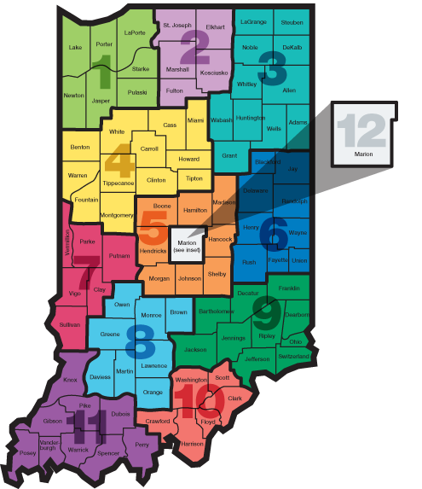
TAA Unit Staff Contacts
Stephanie Butram
Located: WorkOne Lafayette
Regions: 1, 4 and 7
(765) 476-1762
sbutram@dwd.in.gov
Ron Hutcheson, Regional Coordinator
Located: Central Office
Student Reimbursements/RTAA
(317) 220-4638
rhutcheson@dwd.in.gov
Mark Hollman, TAA Support Specialist
Located: Central Office
(317) 232-7367
mhollman@dwd.in.gov
Jacki Anderson
Located: WorkOne Elkhart
Regions: 2, 3, and 6
(574) 361-5451
janderson@dwd.in.gov
Dawn Penn
Located: Kokomo Call Center
Regions: 5 and 12
(765) 431-0160
dpenn@dwd.in.gov
Dee Shrieves
Located: WorkOne Washington
Regions: 8, 9, 10, and 11
(317) 501-9816
dshrieves@dwd.in.gov
Mandy Mahurin, Operations Manager
Located: WorkOne Washington
(812) 881-9514
mmahurin@dwd.in.gov

Slide 26


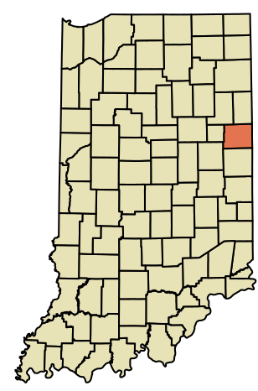
Indiana ADULT EDUCATION
Basic Skills. High School Equivalency. Short-term Training. Certifications and More.
1355 W Tyson Road
Portland, IN 47371
Workforce Education
Initiative
(WEI)
FY2018, Tyson expanded its language and life skills program, known as Upward Academy, to 33 Tyson locations, with plans to eventually make it available to all team members.
J.D. Craft
Dean
Muncie Area Career Center (MACC)
765-747-5250, ext. 5259
Jeremiah.Craft@muncieschools.org

Slide 27

Indiana ADULT EDUCATION
Basic Skills. High School Equivalency. Short-term Training. Certifications and More.
Indiana Career Explorer updates
Contract Extension
Current INCE contract to be extended for one year
Expiration date will be June 30, 2021
DWD looking to revamp training options
Request for Proposal
DWD will be doing the RFP
RFP will cover a career exploration program for adult and secondary users
Per Senate Bill 295, new INCE program will be in place by July 1, 2021

Slide 28
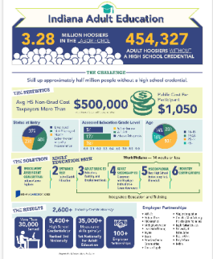
Indiana ADULT EDUCATION
Basic Skills. High School Equivalency. Short-term Training. Certifications and More.
454,327
ADULT Hoosiers Without a High School Credential
Adult Education in Indiana is a Bargain
NEW SECTION
Employer Partnerships
Indiana Adult Education
● The Statistics
● The Solution
● The Results
https://www.in.gov/dwd/2884.htm

Slide 29
Indiana ADULT EDUCATION
Basic Skills. High School Equivalency. Short-term Training. Certifications and More.
Grant Timelines
Critical Dates
● RFA Released
● RFA FAQ Questions
● RFA FAQ Released
● RFA/Grant Application
Submission Deadline
● Award Decisions
#1 RFA Released
2.14.2020
#2 RFA FAQ Questions
2.24.2020
#3 RFA FAQ Released
3.2.2020
#4 RFA/Grant Submissions Due 3.27.2020 5 p.m. EST
#5 Award Decisions
Early May 2020
Workforce Development Board Review
34 CFR §463.21
WDBs will review eligible providers’ application materials to determine whether the applications are consistent with local plans. Local WDBs will submit any recommendations to DWD to promote alignment with the local plan.

Slide 30
Indiana ADULT EDUCATION
Basic Skills. High School Equivalency. Short-term Training. Certifications and More.
Grant RFA
FAQ
Questions & Answers
Q. Can an organization apply just for one portion, in particular can we apply just for the Workforce Education Initiative?
A. Applicants are free to apply for funds to deliver any one, combination, or all categories of services.
Q. For participants within the Workforce Education Initiative, do participants need to complete the TABE?
A. Yes
Is the instructor credentialing the same across all areas that are funded (such as WEI)?
A. Yes – Minimum of a bachelor’s degree.
Grant Applicants Due March 27, 2020
5 p.m. EST
NO EXCEPTIONS

Slide 31
Indiana ADULT EDUCATION
Basic Skills. High School Equivalency. Short-term Training. Certifications and More.
Grant RFA
FAQ
Questions & Answers
Q. Are the new requirements for new PDFs only or does this apply to current PDFs who will continue in that role next year?
A. PDFs will be chosen on a case-by-case basis as part of the PDF application process. The requirements listed in the RFA will apply to all PDF applicants in program year 2020.
Q. There was no mention of 64% gains as a statewide goal. Is there a goal this year that has been determined already?
A. No. Indiana's performance targets will be negotiated by DWD and USDOE at a later date.
Grant Applicants Due March 27, 2020
5 p.m. EST
NO EXCEPTIONS

Slide 32
Indiana ADULT EDUCATION
Basic Skills. High School Equivalency. Short-term Training. Certifications and More.
Grant RFA
FAQ
Questions & Answers
Q. There was no mention of 64% gains as a statewide goal. Is there a goal this year that has been determined already?
A. No. Indiana's performance targets will be negotiated by DWD and USDOE after finalization of the Indiana state plan.
Q. Can grant funds be used for HSE assessment products?
A. Yes (instructional materials to prepare for the HSE).
Q. Can grant funds be used for HSE online testing fees?
A. No (funds cannot be used to pay for HSE testing fees).
Grant Applicants Due March 27, 2020
5 p.m. EST
NO EXCEPTIONS

Slide 33
Indiana ADULT EDUCATION
Basic Skills. High School Equivalency. Short-term Training. Certifications and More.
Grant RFA
FAQ
Questions & Answers
Q. Is there a maximum percentage set for the administrative percentage waiver?
A. Indiana’s maximum percentage is 15 percent.
Q. Will IELCE monies be subdivided out during the grant process or will it be included in the adult education grant monies total for the duration of the grant process?
A. IELCE funding is separate from ABE funding. Applicants must submit a separate grant application in order to be considered for IELCE funding.
Grant Applicants Due March 27, 2020
5 p.m. EST
NO EXCEPTIONS

Slide 34
Indiana ADULT EDUCATION
Basic Skills. High School Equivalency. Short-term Training. Certifications and More.
Grant RFA
FAQ
Questions & Answers
Q. When listing the total number of individual applicants that will be served, do we provide the total number of il applicants for the current grant year cycle, or is it for the three-year period?
A. Unless otherwise specified, information requested is for the first year of the upcoming grant cycle – July 1, 2020 - June 30, 2021.
Q. Why are there regional allocation estimates instead of individual programs?
A. We do not know how many entities will receive funding. Therefore, regional allocation estimates were developed for this competition.
Grant Applicants Due March 27, 2020
5 p.m. EST
NO EXCEPTIONS

Slide 35
Indiana ADULT EDUCATION
Basic Skills. High School Equivalency. Short-term Training. Certifications and More.
Grant RFA
FAQ
Questions & Answers
Q. In the demonstrated effectiveness template, are we supposed to include educational functioning level percentages?
A. Only include the number of outcomes for each category. The percentage of measurable skill gains will be calculated by the RFA scoring team after submission.
Q. Should our budgets differentiate between state and federal funding, or does our funding need to be put in state only?
A. DWD will provide the state/federal breakdown to grant awardees following the competition.
Grant Applicants Due March 27, 2020
5 p.m. EST
NO EXCEPTIONS

Slide 36
Indiana ADULT EDUCATION
Basic Skills. High School Equivalency. Short-term Training. Certifications and More.
Grant RFA
FAQ
Questions & Answers
Q. The grant application states that PDFs cannot be full-time. What is considered full-time?
A. DWD considers anyone with more than thirty (30) hours full time, and acceptance as a PDF is made on a case-by-case basis as part of the PDF application process.
Q. To confirm, the GEPA plan is to be submitted separately from the narrative and not also included in the narrative?
A. Correct. The GEPA plan should be submitted as a separate attachment.
Grant Applicants Due March 27, 2020
5 p.m. EST
NO EXCEPTIONS

Slide 37
Indiana ADULT EDUCATION
Basic Skills. High School Equivalency. Short-term Training. Certifications and More.
Grant RFA
FAQ
Questions & Answers
Q. The RFA says that adult education programs must utilize academic and career coaches. Can they be volunteers or interns who work free of charge?
A. Academic and career coaches can be either volunteers or interns; however, any person holding this position must meet Indiana's qualification requirements and would be included on a program's NRS Table 7.
Q. If I want to apply for counties in Region X and a county in Region Y, is that one ABE application or two applications?
A. Only one grant application is required.
Grant Applicants Due March 27, 2020
5 p.m. EST
NO EXCEPTIONS

Slide 38
Indiana ADULT EDUCATION
Basic Skills. High School Equivalency. Short-term Training. Certifications and More.
Grant RFA
FAQ
Questions & Answers
Q. For demonstrated effectiveness, are we supposed to try to contact past (HSE) students to get their pay and how many are gainfully employed?
A. DWD does frequently data match Indiana's WIOA Title II participants with UI wage data; however, this data match will not capture all participants and former participants, and (because of the nature of UI wage data) is always six (6) months behind the current date; therefore, applicants should plan on (and current providers should) doing follow-up with their WIOA Title II participants.
Grant Applicants Due March 27, 2020
5 p.m. EST
NO EXCEPTIONS

Slide 39
Indiana ADULT EDUCATION
Basic Skills. High School Equivalency. Short-term Training. Certifications and More.
Grant RFA
FAQ
Questions & Answers
Q. What about students who have been with us for awhile and then go to IOO to finish. Does that information bear upon our success at all?
A. The Indiana Online Only Distance Education program is designed to allow both the IOODE provider and the local provider to receive “credit” for an IOODE participant’s performance.
Q. Please define program year and timeframes – PY 17; PY18.
A. Program years begin on July 1 of the current year and end on June 30 of the following year. Ex. Program Year 2020 (PY20) will begin on July 1, 2020 and end on June 30, 2021.
Grant Applicants Due March 27, 2020
5 p.m. EST
NO EXCEPTIONS

Slide 40
Indiana ADULT EDUCATION
Basic Skills. High School Equivalency. Short-term Training. Certifications and More.
Grant RFA
FAQ
Questions & Answers
Q. Will WEI and IET funding work the same way it does for program year 2019 - 2020?
In PY 2020, WEI and IET funds will be interchangeable. This means that, while the use of funds for either WEI or IET programs will still need to be tracked separately, WEI funds can be used to fund normal IET programs and IET funds can be used to fund WEI programs.
Q. Can two adult education programs offer services in the same county?
A. More than one adult education provider may apply to offer services in the same county.
Grant Applicants Due March 27, 2020
5 p.m. EST
NO EXCEPTIONS

Slide 41
Indiana ADULT EDUCATION
Basic Skills. High School Equivalency. Short-term Training. Certifications and More.
Grant RFA
FAQ
Questions & Answers
Q. Do we need to complete the demonstrated effectiveness form for each one of our subcontractors?
A. Yes. Any consortium applying for funds must complete and submit this template for each consortium member; this includes eligible providers that plan to use subcontracted entities.
Q. I noticed that we got an updated RFA. What happens if I submit my application early and another item is changed?
A. You will only be accountable for information that is released up to the date that you submit your application. If something changes after an application is received, we will allow the applicant time to make corrections.
Grant Applicants Due March 27, 2020
5 p.m. EST
NO EXCEPTIONS

Slide 42
Indiana ADULT EDUCATION
Basic Skills. High School Equivalency. Short-term Training. Certifications and More.
REMINDER
Workforce Development Board Review
34 CFR §463.21
WDBs will review eligible providers’ application materials to determine whether the applications are consistent with local plans. Local WDBs will submit any recommendations to DWD to promote alignment with the local plan.
RFA/Grant Submissions
Due 3.27.2020
5 p.m. EST
No EXCEPTIONS
Grant Timelines
Critical Dates
● RFA/Grant Application
Submission Deadline
● Award Decisions

Slide 43
Indiana ADULT EDUCATION
Basic Skills. High School Equivalency. Short-term Training. Certifications and More.
REMINDER
Expend State Dollars
FIRST
Why this is important . . .
PY 2019-2020 GRANT INFORMATION
Your Grants Team is available to respond to any questions –
  • Donna Lovelady dlovelady@dwd.in.gov 317.233.9902
  • Scott Mills smills1@dwd.in.gov 317.864.2248

Slide 44
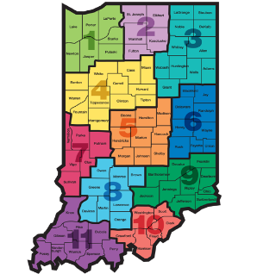
Indiana ADULT EDUCATION
Basic Skills. High School Equivalency. Short-term Training. Certifications and More.
Professional Development
NEXT
STEPS
Moving Forward
2019-2020
Professional Development
Teaching Struggling Learners with Difficulties/Disabilities
Results from February Training
Future Plans

Slide 45
TEACHING STRUGGLING LEARNERS WITH DIFFICULTIEs
DISABLITIES
Indiana ADULT EDUCATION
Basic Skills. High School Equivalency. Short-term Training. Certifications and More.
Professional Development
“I appreciate that Jeff (the trainer) knew his content from experience, not just books.”
“Any more workshops scheduled?”
● How to identify students with LD ● Additional services/laws available to assist students with LD ● Tools to help teachers understand different strategies to use with LD students
“I’d love a longer, more in-depth training!”
Jeff Fantine
“The way he explained, and put to practice what he was teaching was very helpful. I loved how he gave out and evaluated assessments.”
Fantine Academic & Career Training Services

Slide 46

TEACHING STRUGGLING LEARNERS WITH DIFFICULTIEs
DISABLITIES
Indiana ADULT EDUCATION
Basic Skills. High School Equivalency. Short-term Training. Certifications and More.
Professional Development
“When I teach the Pythagorean theorem, I usually teach the concept of the 3-4-5 triangle first before I get into formula. We used manipulatives that we bought a long time ago and first
showed the 3-4-5 lengths of a
right triangle. We then ‘squared’
them to use 9, 16, and 25 squares,
respectively, to see that if you
add the 9 and the 16, you get 25.
Eyes rolled a bit when I dumped
out the squares.”
Jeff Fantine
Fantine Academic & Career Training Services

Slide 47
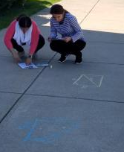
TEACHING STRUGGLING LEARNERS WITH DIFFICULTIEs
DISABLITIES
Indiana ADULT EDUCATION
Basic Skills. High School Equivalency. Short-term Training. Certifications and More.
Professional Development
“Later said that they were glad that we used them so they could really see and understand why the formula worked. They reported the activity made using the formulas much more easy to understand when working through the practice worksheets. I also had easy, medium, and difficult worksheets so that students could start at a level that they were comfortable.”
In the past, teachers have used sidewalk chalk to draw out the word problems.
Jeff Fantine
Fantine Academic & Career Training Services

Slide 48
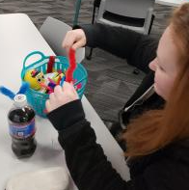
TEACHING STRUGGLING LEARNERS WITH DIFFICULTIEs
DISABLITIES
Indiana ADULT EDUCATION
Basic Skills. High School Equivalency. Short-term Training. Certifications and More.
Professional Development
“This is Lauren. She is one of our ‘struggling learners’ who comes to me twice a week for one-on-one instruction in math. She down to ‘math-only’ after about three years in and out of our program. She has diagnosed ADD among other things.”
“She LOVED the sensory basket and played with everything in it. She can usually focus for about 20, then she starts making silly mistakes. She is usually completely DONE after about 40 minutes.”
Jeff Fantine
Fantine Academic & Career Training Services

Slide 49
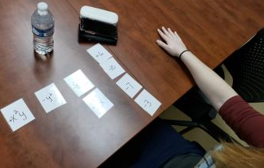
TEACHING STRUGGLING LEARNERS WITH DIFFICULTIEs
DISABLITIES
Indiana ADULT EDUCATION
Basic Skills. High School Equivalency. Short-term Training. Certifications and More.
Professional Development
“We have been working on polynomials. She has trouble with things like copying the problem accurately, finding the part of each term that she needs to look at, and keeping the signs with the terms. for almost an hour.
“This modification keeps her hands busy and eliminates all of her handwriting issues. She loves it! She was able to focus and work productively.”
Jeff Fantine
Fantine Academic & Career Training Services

Slide 50
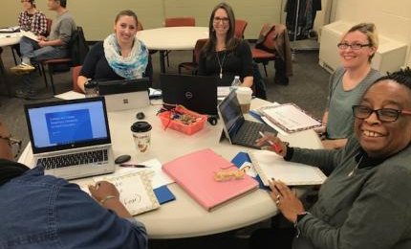
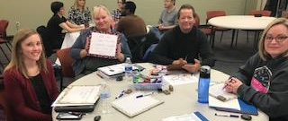
New Teacher Training
Indiana ADULT EDUCATION
Basic Skills. High School Equivalency. Short-term Training. Certifications and More.
Professional Development
Jeff Fantine
Sara Gutting
Fantine Academic &
Career Training Services

Slide 51
Indiana ADULT EDUCATION
Basic Skills. High School Equivalency. Short-term Training. Certifications and More.
Professional Development
New Teacher Training
“Lesson structuring and basics of new teacher training elements were very helpful – especially since I am a completely new to teaching!”
● “I enjoyed learning more strategies for using in the classroom and found the adult education teacher handbook had many resources!”
● “It was helpful to hear from a variety of teacher from their respective parts of the state.”
● “I learned a number of warm up activities and lesson to keep students motivated, especially those who do not attend class on a regular basis.”

Slide 52
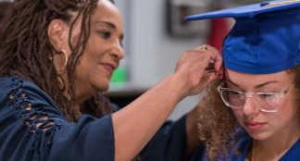
Indiana ADULT EDUCATION
Basic Skills. High School Equivalency. Short-term Training. Certifications and More.
Academic & Career Coaches beginning in PY 2020
Must Have an Earned Bachelor’s Degree
Program Year 2020
July 1, 2020 – June 30, 2021
DWD will mandate that applicants awarded funds as part of the new RFA (Grant Year 2020-2021) utilize academic and career coaches.
Academic
& Career Coaches

Slide 53
Indiana ADULT EDUCATION
Basic Skills. High School Equivalency. Short-term Training. Certifications and More.
Program Year 2020
July 1, 2020 – June 30, 2021
Career Coach Responsibilities
Academic and Career Coaches connect with students, create plans to diminish barriers, develop career pathways, refer students to community resources and employers, and provide work readiness training to classes.
Academic and Career Coaches also work with adult education students to assist them in accessing career, training, and post-secondary opportunities.
Academic
& Career Coaches

Slide 54
Indiana ADULT EDUCATION
Basic Skills. High School Equivalency. Short-term Training. Certifications and More.
Career Coach
Responsibilities
Program Year 2020
July 1, 2020 – June 30, 2021
Academic and Career Coaches will create Individual Employment Plans with students. Plans include a list all barriers to employment, interests, potential employers in an area, and/or educational pathways.
Academic
& Career Coaches
Career
Coaching
Survey

Slide 55
Indiana ADULT EDUCATION
Basic Skills. High School Equivalency. Short-term Training. Certifications and More.
Questions - Please do not hesitate to contact –
Jose Torres
Academic & Career Coach Liaison
219.286.4513
jtorres@dwd.in.gov
Academic
& Career Coaches
Career Coaching
Contact

Slide 56

Indiana ADULT EDUCATION
Basic Skills. High School Equivalency. Short-term Training. Certifications and More.
Workforce Initiative Coordinator
for Adult Education
Roy Melton
rmelton@dwd.in.gov
765.413.2216

Slide 57


program is open to anyone age 16 or older who is not attending a high school. It helps people prepare for the equivalency test, earn workforce
certification and even learn English as a second language.
“It’s really all about getting people into career training and employment,” said Robert Moore, director of the program.
The program serves about 500 people each year. Historically, there has been one ceremony in May to recognize their accomplishments. A second
ceremony was added in December this year.
“- 1
Indiana ADULT EDUCATION
Basic Skills. High School Equivalency. Short-term Training. Certifications and More.
►Integrated Education & Training
IELCE | Short-term Training | Certifications
You need to follow the American dream and expect a lot from yourself because the sky is the limit!”
–Johanna Hern, Adult Learner
IET Enrollment 2,637 IELCE Enrollment 148
Still Enrolled 1,324 Still Enrolled 120
Dropped 159 Dropped 7
Completions 1,154 Completions 21
Certifications 975 Certifications 9
AK Smith Area
Career Center
Adult Education

Slide 58

STATEWIDE | Goal | To-Date
Enrollment | 1,800 | 270
Enrollment Rate | --- | ---
Still Enrolled | --- | 69
Completers | 1,440 | 185
Completion Rate | 80% | 92.04%
Dropped | --- | 16
Dropped Rate | Below 10% | 7.6%
Certifications issued | 1,065 | 155
Certification Rate | 74% | 83.78%
Employment | 640 | 72
Employment Rate | 60% | 43.78%
WorkINdiana
Updates
Statewide
Brin Sisco
Training and System Administrator
Department Of Workforce Development
10 N. Senate Avenue
Indianapolis, IN 46204
317.234.4278 BSisco@dwd.in.gov

Slide 59

Indiana ADULT EDUCATION
Basic Skills. High School Equivalency. Short-term Training. Certifications and More.
Workforce Education Initiative
“Now that I have my HSE so many doors have opened up. Before, I was only able to work for places where the company took people that didn’t have a diploma or HSE. I am so glad I did this.”
– Malcom Sherrod
RVR Adult Education,
Region 10
WEI monthly data report
statewide enrollments –
WEI Enrollments 1,390

Slide 60
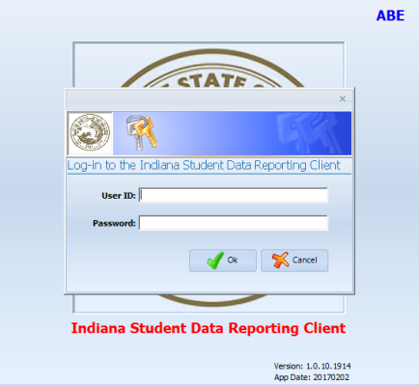
program is open to anyone age 16 or older who is not attending a high school. It helps people prepare for the equivalency test, earn workforce
certification and even learn English as a second language.
“It’s really all about getting people into career training and employment,” said Robert Moore, director of the program.
The program serves about 500 people each year. Historically, there has been one ceremony in May to recognize their accomplishments. A second
ceremony was added in December this year.
“- 1
InTERS
ADULT EDUCATION UPDATES, TRAININGS
Matt Crites
mcrites@dwd.in.gov
Brin Sisco
bsisco@dwd.in.gov

Slide 61
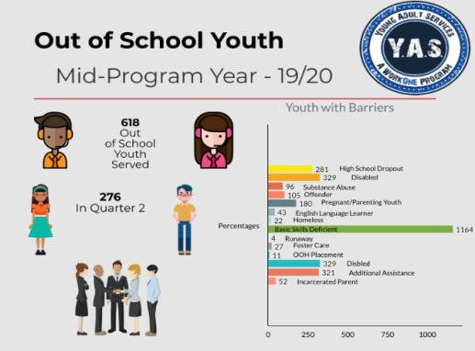
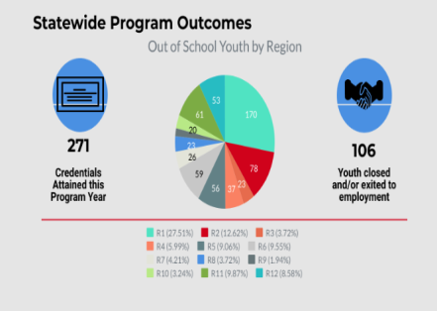
Youth Initiatives Updates
Michael Coleman
Young Adult and Special Populations Manager
mcoleman3@dwd.in.gov

Slide 62

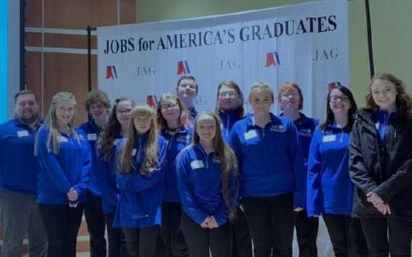
State Career Development Conference
March 13, 2020
Ivy Tech Community College
Culinary Arts Center
2820 N Meridian St. Indianapolis, IN 46208

Slide 63
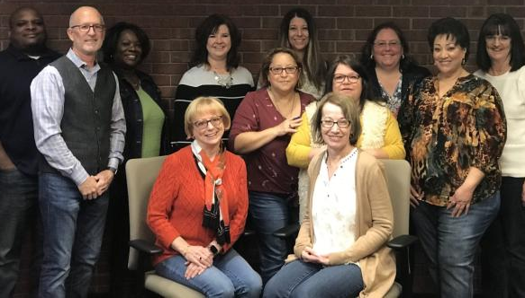
Region 2 Visit
Director of Youth Initiatives, Brianna Morse and I met with the Out of School Youth Staff representing Region 2 to discuss ways we can improve making a difference in the lives of young people, as well as special populations such as juvenile justice youth, homeless youth, and foster youth.
Steve Ferber, Director of Gateway Education Center has been invaluable to Tonya Pope and represents a shining example of how we can work together to benefit fellow Hoosiers!
Adult education has been a great partner with helping refer people to out of school youth services.

Slide 64
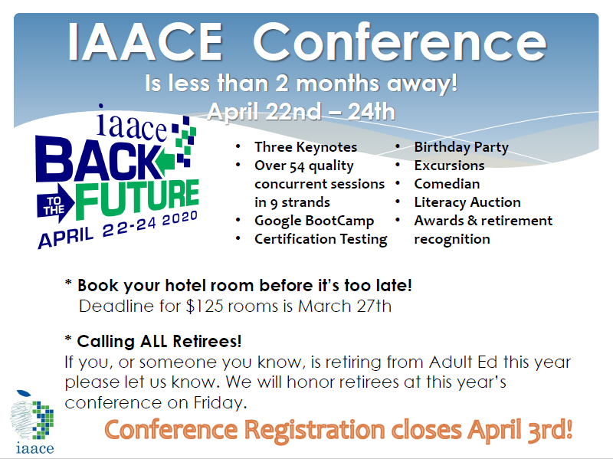
program is open to anyone age 16 or older who is not attending a high school. It helps people prepare for the equivalency test, earn workforce
certification and even learn English as a second language.
“It’s really all about getting people into career training and employment,” said Robert Moore, director of the program.
The program serves about 500 people each year. Historically, there has been one ceremony in May to recognize their accomplishments. A second
ceremony was added in December this year.
“- 1

Slide 65

program is open to anyone age 16 or older who is not attending a high school. It helps people prepare for the equivalency test, earn workforce
certification and even learn English as a second language.
“It’s really all about getting people into career training and employment,” said Robert Moore, director of the program.
The program serves about 500 people each year. Historically, there has been one ceremony in May to recognize their accomplishments. A second
ceremony was added in December this year.
“- 1

Slide 66
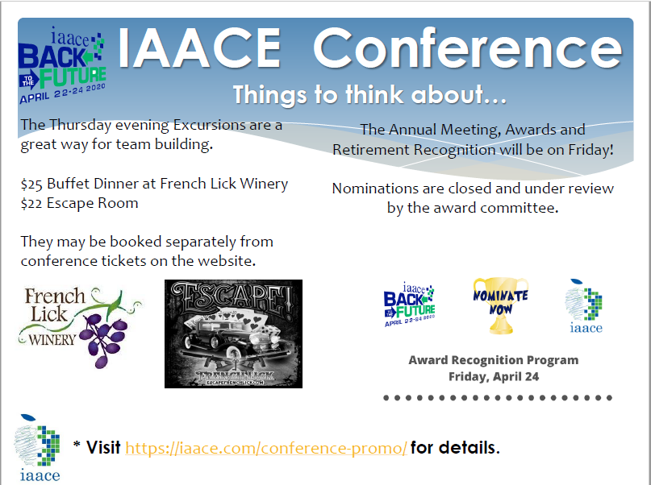
program is open to anyone age 16 or older who is not attending a high school. It helps people prepare for the equivalency test, earn workforce
certification and even learn English as a second language.
“It’s really all about getting people into career training and employment,” said Robert Moore, director of the program.
The program serves about 500 people each year. Historically, there has been one ceremony in May to recognize their accomplishments. A second
ceremony was added in December this year.
“- 1

Slide 67
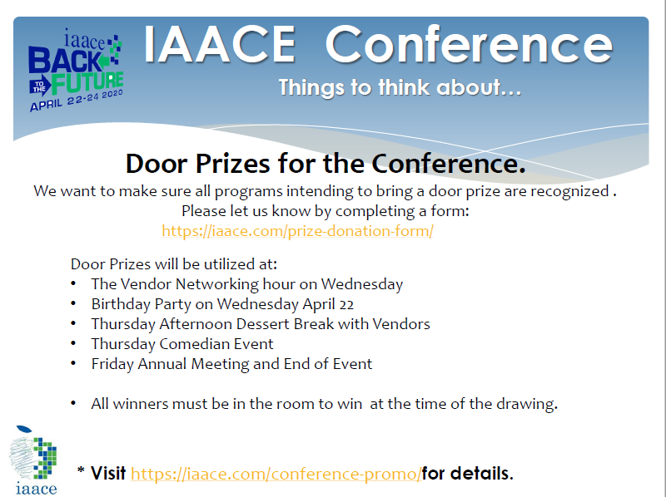
program is open to anyone age 16 or older who is not attending a high school. It helps people prepare for the equivalency test, earn workforce
certification and even learn English as a second language.
“It’s really all about getting people into career training and employment,” said Robert Moore, director of the program.
The program serves about 500 people each year. Historically, there has been one ceremony in May to recognize their accomplishments. A second
ceremony was added in December this year.
“- 1

Slide 68
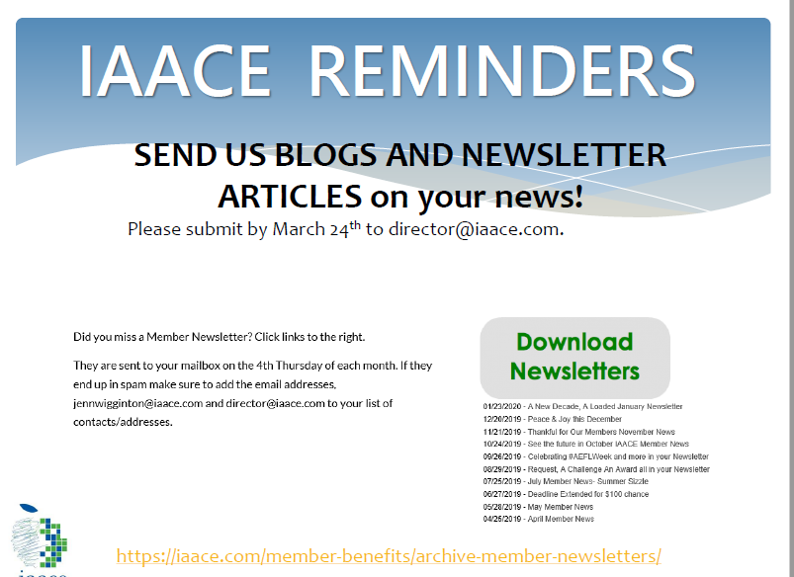
program is open to anyone age 16 or older who is not attending a high school. It helps people prepare for the equivalency test, earn workforce
certification and even learn English as a second language.
“It’s really all about getting people into career training and employment,” said Robert Moore, director of the program.
The program serves about 500 people each year. Historically, there has been one ceremony in May to recognize their accomplishments. A second
ceremony was added in December this year.
“- 1

Slide 69
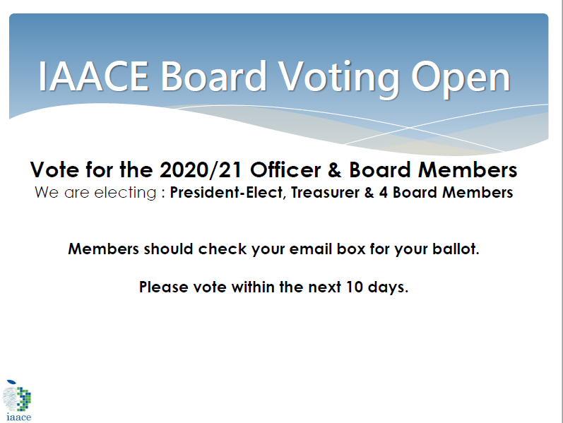
program is open to anyone age 16 or older who is not attending a high school. It helps people prepare for the equivalency test, earn workforce
certification and even learn English as a second language.
“It’s really all about getting people into career training and employment,” said Robert Moore, director of the program.
The program serves about 500 people each year. Historically, there has been one ceremony in May to recognize their accomplishments. A second
ceremony was added in December this year.
“- 1

Slide 70
program is open to anyone age 16 or older who is not attending a high school. It helps people prepare for the equivalency test, earn workforce
certification and even learn English as a second language.
“It’s really all about getting people into career training and employment,” said Robert Moore, director of the program.
The program serves about 500 people each year. Historically, there has been one ceremony in May to recognize their accomplishments. A second
ceremony was added in December this year.
“- 1
Connecting & Engaging.
It’s What We Do!
Next Adult Education & Workforce Development Statewide Webinar
5.13.2020
10 to 11:30 a.m. ET
No Webinar – April 2020 | See you in French Lick

