Slide 1


Connecting & Engaging.
It’s What We Do!
Adult Education and Workforce Development Statewide Webinar
September 11, 2019
Marilyn Pitzulo | Adult Education Staff
Department of Workforce Development | Indiana ADULT EDUCATION
10 N. Senate Avenue, IGCS SE 203 | Indianapolis, IN 46204
AdultEd@dwd.in.gov

Slide 2


Indiana ADULT EDUCATION
Basic Skills. High School Equivalency. Short-term Training. Certifications and More.
A Never Ending STRUGGLE
“Just go for it! It's never too late to better yourself and your family. I'm 34 and I never thought I would have ever been able to attend college, but here I am, I'm doing it. It's never too late.”
A single mother of two living in government housing, Heather West, was struggling. Left on her own to care for her two children after their father’s incarceration, she grew tired of the struggle.
–Heather West

Slide 3
Indiana ADULT EDUCATION
Basic Skills. High School Equivalency. Short-term Training. Certifications and More.
"I was sick of struggling and living off of government assistance," says West, "seven years is long enough. It's time for a change."
Education Program in Michigan City, West began to see more for her future beyond earning her HSE.
"I've always struggled with learning problems, and have always doubted myself, but now I have the confidence to continue my education," said West. As a recent graduate of A.K Smith Area Career Center's Adult Education Program, West achieved her goal of getting her HSE.
West knew that in order to provide a better life for herself and her children, she would need to get her High School Equivalency (HSE). After beginning classes at A.K. Smith Area Career Center’s Adult
Heather West

Slide 4

Indiana ADULT EDUCATION
Basic Skills. High School Equivalency. Short-term Training. Certifications and More.
LaPorte Co. Career & Technical Education
A. K. Smith Career Center
"I have signed up to receive my certificate in phlebotomy. I have also decided to attend Ivy Tech. The possibilities are endless. If it wasn't for this program, I couldn't have bettered mine or my children's lives. It helps so many mothers, fathers, children, and families. So, thank you, for everything," said West.
A Never Ending
STRUGGLE
"The best part of the program was me passing my HSE on the first try," says West, "it was also nice to have the support I need to go to college."
West has decided to continue her education. After earning her HSE, she began working with WorkOne staff to register for a phlebotomy training program at Ivy Tech.
Heather West

Slide 5



Indiana ADULT EDUCATION
Basic Skills. High School Equivalency. Short-term Training. Certifications and More.
HIP GATEWAY TO WORK
“Indiana is at the onset of a jobs explosion! In the next 10 years, we expect to need some 1 million workers to fill jobs. Gateway to Work is part of the Healthy Indiana Plan that helps connect HIP members with job training, education or help finding the right job or volunteer activity. Whether you’re looking for a job or place to volunteer, a better-paying job or new skills, Gateway to Work can help.”
Elizabeth Crist Darby, MPA ▪ HIP Gateway to Work Director
Indiana Medicaid ▪ Indiana Family and Social Services Administration
402 W. Washington St., Room W374 ▪ MS07 ▪ Indianapolis, IN 46204
317.233.5621
Elizabeth.Darby@fssa.IN.gov ▪ http://www.in.gov/fssa
Find Opportunities
to Work, Learn,
and Serve

Slide 6

Gateway to Work
&
Adult Education
September 11, 2019

Slide 7
Overview
Gateway to Work is part of the Healthy Indiana Plan, but only some members are required to participate.
Goal of improving physical and mental health and the individual’s overall financial stability and well-being.
Provides resources and connections to help members
  Gain work or improve employment
  Further their education
  Increase community involvement

Slide 8
Exemptions
Definitions online at HIP.IN.gov/Gateway to Work or members can call their health plan to discuss
Caregiver of a dependent child under 7 years old
Caregiver of a disabled dependent
Homeless
Illness (Certified) or incapacity (Temporary)
Institutionalized
Kinship caregiver of an abused or neglected child
Medically frail
Pregnant
Recently incarcerated
Student (half or full-time)
Substance use disorder
Age 60 years and older
TANF or SNAP recipient
Other possible exemptions will be reviewed for good cause on an individual basis

Slide 9
SUD Related
Exemptions
MCE can automatically add exemption based on claims.
Prior Approval and/or referral is not enough. Must receive a covered treatment.
Covered Treatments
  Individual & group counseling
  Inpatient treatment
  Residential treatment
  Intensive outpatient treatment
  Partial hospitalization
  Medication-assisted treatments (for opioid treatment only)

Slide 10
Exempt Members
Should…
VERIFY THAT EXEMPTION HAS BEEN ADDED BY CALLING MCE
Are not required to do anything for months in this status.
Can participate if they would like.
If short term exemption, should make plans for future reporting.

Slide 11
Reporting Members
HIP members who do not meet an exemption or are already working will be required to do qualifying activities.
Hours are self-reported and no documentation is required
Members can log their own hours online or report via telephone to MCE.
All GTW participants earned credit for January – June of 2019. Must report hours for July – December 209

Slide 12
GTW: Hours Phase
Program Phase In:
  Started January 2019 with Zero required hour per month
  Required hours incrementally increasing over 18 months for all members
2019 |  | 2020 |  | 2021
1/1/2019-6/30/2019 | 7/1/2019-9/30/2019 | 10/1/2019-12/31/2019 | 1/1/2020-6/30/2020 | 7/1/2020- ongoing
0 hours | 20 hrs/month | 40 hrs/month | 60 hrs/month | 80 hrs/month
You Are Here

Slide 13
Reporting Members
Should…
  Utilize web site to learn more about the Gateway to Work program.
  Take an assessment on-line or by calling health plan. (no log-in required to participate).
  Pick activity/combination of activities and report those via FSSA benefit portal or by calling their health plan.

Slide 14
Qualifying Activities
“Work”
Employment (subsidized or unsubsidized)
Job search activities
Education related to employment (on-the-job training)
“Serve”
Community service/public service
Volunteer work
Caregiving services
“Learn”
High School Equivalency (HSE)
Adult education
Post-secondary
General education
Job skills training
Vocation education or training
English as a second language education

Slide 15

HIP.in.gov (click on Gateway to Work)

Slide 16
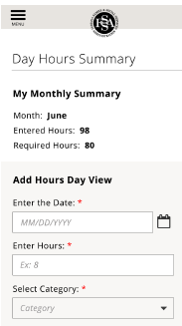

FSSA Benefit Portal

Slide 17
Member
Communications
Emails
Postcards
Eligibility Notices
Health Plan Letters
Monthly Status – Gateway to Work status is included on monthly Power Account status – since March
Digital Advertising

Slide 18


Member
Communications
Postcard

Slide 19
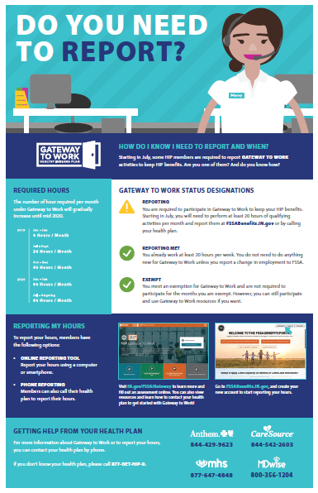
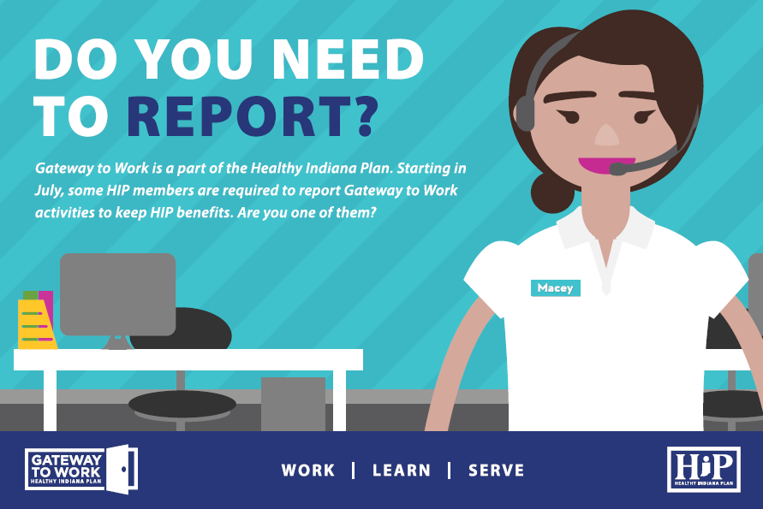
How to report hours

Slide 20
Help for Members
MCE (Anthem, CareSource, MDWise, MHS)
  General member questions
  Exemption notification and/or requests
  Good Cause exemption requests
  Reporting hours
  Assistance and referrals
Gateway to Work Unit
  Eligibility Issues & Good Cause reviews
  General process questions
  At-Risk/suspend members support (beginning in Nov.)

Slide 21
Pre-suspension
Support
Outreach in Oct, Nov & December
Pre-Suspension Activities
    Online or paper versions
    Credit for 1 month of hours
Exemptions can over-ride suspension
Reminder – members is suspended effective Jan. 1, 2020, not terminated. Can re-activate within 3 business days and provide retro coverage as medically necessary

Slide 22
How to Help with
Outreach
Register with GTW to provide volunteer activities, access to computers, etc.
HIP.IN.gov
    General program brochures
    Key terms brochures and posters
    Infographic about enrolling in HIP
    Order form for FREE materials
    Sign up as a HIP Stakeholder

Slide 23
Contact Information
Elizabeth Crist Darby,
Gateway to Work Director
317-233-5621
Elizabeth.darby@fssa.in.gov
General questions: FSSA.GatewayToWork@fssa.in.gov

Slide 24


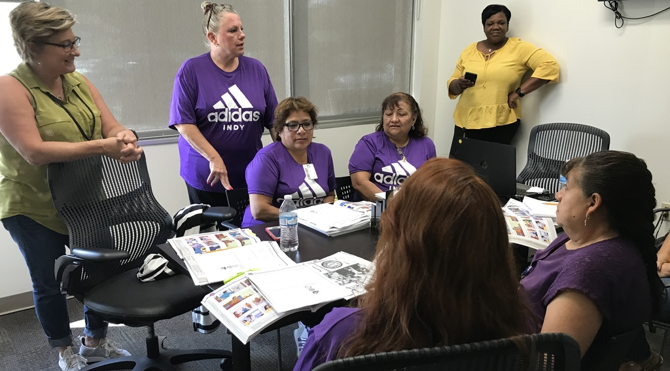

Indiana ADULT EDUCATION
Basic Skills. High School Equivalency. Short-term Training. Certifications and More.
Photos by Natalie Reuter
400 West New Road
Greenfield
8677 Logo Athletic Ct., Indianapolis

Slide 25

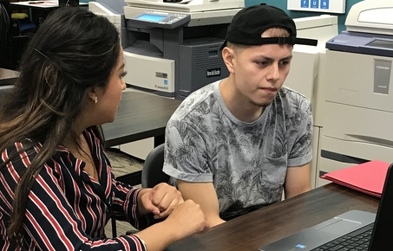



Indiana ADULT EDUCATION
Basic Skills. High School Equivalency. Short-term Training. Certifications and More.
Brenda Owen
Director of Adult & Continuing Education
MSD of Warren Township
Walker Career Center
317.532.6155
bowen@warren.k12.in.us
1255 Roosevelt Avenue
Indianapolis
Workforce Training
Creating jobs and changing lives.
Natalie Reuter
Adult Education Supervisor
MSD of Warren Township
nreuter@warren.k12.in.us

Slide 26


Workforce Education Initiatives (WEI)

Slide 27


WEI
Keihin, N.A.

Slide 28

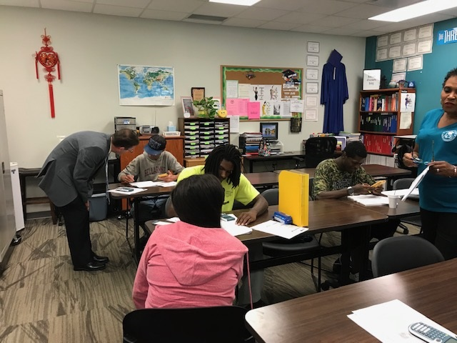
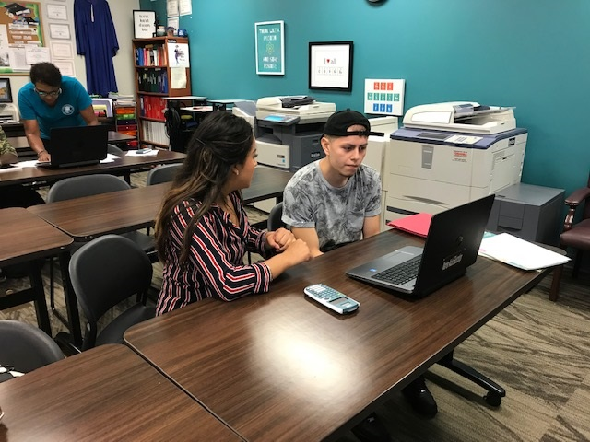
WEI
RecycleForce &
Keys to Work

Slide 29

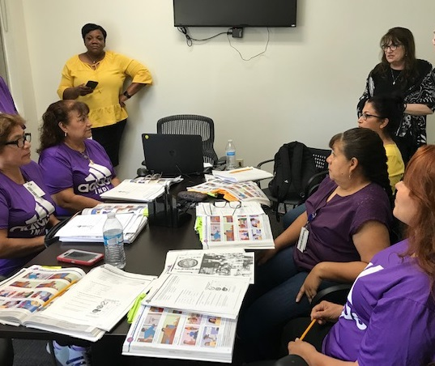

WEI
Adidas INDY

Slide 30
Indiana ADULT EDUCATION
Basic Skills. High School Equivalency. Short-term Training. Certifications and More.
“Sign-in/Sign-out Sheets”
ATTENDANCE LOGS
Sign-in | Learning Activity Logs
“Sign-in and learning activity logs shall be completed on a daily basis.”
Actual Student Signatures
DWD Policy 2013-07
Adult Education Program Standards
Indiana Adult Education Teachers’ Manual
“Sign-in/Sign-out Sheets”

Slide 31
Indiana ADULT EDUCATION
Basic Skills. High School Equivalency. Short-term Training. Certifications and More.
“Sign-in/Sign-out Sheets”
ATTENDANCE LOGS
Sign-in | Learning Activity Logs
“Sign-in and learning activity logs shall be completed on a daily basis.”
Minimum Requirements | Sign-in/Sign-Out Sheets
Name of Class
Date| Class Times
Space for ACTUAL Student Signatures
Space for student to write in times when he/she entered and left class
Optional
Teacher’s Name
Preprinted form with student names for readability
DWD Policy 2013-07
Adult Education Program Standards
Indiana Adult Education Teachers’ Manual
“Sign-in/Sign-out Sheets”

Slide 32
Indiana ADULT EDUCATION
Basic Skills. High School Equivalency. Short-term Training. Certifications and More.
Program
INCOME
Workforce Innovation and Opportunity Act (WIOA), Title II – Adult Education and Family Literacy Act (AEFLA)
Workforce Innovation and Opportunity Act (WIOA), Title II – Adult Education and Family Literacy Act (AEFLA)
Local providers charging fees to participants must use the generated program income for allowable costs under AEFLA, including expanding available resources for adult education, workplace literacy, English language acquisition, and adult basic and secondary education.
Fees established by local programs must be necessary and reasonable and must not impose a barrier to the participation of disadvantaged persons in the adult education program.

Slide 33
Indiana ADULT EDUCATION
Basic Skills. High School Equivalency. Short-term Training. Certifications and More.
Program
INCOME
DWD Policy 2015-12
Adult Education Funding Policy
Programs choosing to charge fees must reinvest the funds in the adult education program before requesting additional grant money for the same activity in accordance with 34 CFR 80.21(f). Additionally, all income from fees must be spent during the same program year. DWD requires programs to report fees and how these funds were reinvested.
Any fees charged may not be applied towards Maintenance of Effort requirements.

Slide 34
Indiana ADULT EDUCATION
Basic Skills. High School Equivalency. Short-term Training. Certifications and More.
Program
INCOME
DWD Policy 2015-12
Adult Education Funding Policy
DWD requires programs that charge fees to establish a fee policy that –
► Addresses fee requirements and exceptions;
► Contains a schedule for fee payments;
► Creates standards that address how fees will not impose barriers to the student.
Programs must disclose any associated fees to students prior to orientation.

Slide 35
Indiana ADULT EDUCATION
Basic Skills. High School Equivalency. Short-term Training. Certifications and More.
DWD Policy 2017-14
Distance Education
Distance
Education
Policy
Workforce Innovation and Opportunity Act (WIOA), Title II – Adult Education and Family Literacy Act (AEFLA)
Programs must provide documentation of proxy contact hours.
Clock-time | Teacher Verification | Learner Mastery Models
► Retain a “representative sample” of student work (e.g., homework packets) completed through distance education. It is not necessary to retain every assignment.
► Ensure there is sufficient detail entered on the distance learning log to outline the assignment completed. Include dates and times (proxy hours) on the log. A space for teacher and student signatures on the log provides further documentation.
https://www.in.gov/dwd/files/AE%20Distance%20Education%20Policy.pdf

Slide 36

program is open to anyone age 16 or older who is not attending a high school. It helps people prepare for the equivalency test, earn workforce
certification and even learn English as a second language.
“It’s really all about getting people into career training and employment,” said Robert Moore, director of the program.
The program serves about 500 people each year. Historically, there has been one ceremony in May to recognize their accomplishments. A second
ceremony was added in December this year.
“- 1
Indiana ADULT EDUCATION
Basic Skills. High School Equivalency. Short-term Training. Certifications and More.
Mid-Year
Incentive
Achieving
Performance
Outcomes
REQUIREMENTS
Grantees will receive a mid-year performance incentive for achieving 50 percent on NRS Table 4, Column I, by 12.31.19.

Slide 37

program is open to anyone age 16 or older who is not attending a high school. It helps people prepare for the equivalency test, earn workforce
certification and even learn English as a second language.
“It’s really all about getting people into career training and employment,” said Robert Moore, director of the program.
The program serves about 500 people each year. Historically, there has been one ceremony in May to recognize their accomplishments. A second
ceremony was added in December this year.
“- 1
Indiana ADULT EDUCATION
Basic Skills. High School Equivalency. Short-term Training. Certifications and More.
REQUIREMENTS
Grantees will receive a mid-year performance incentive for 15 percent of ABE adult education enrollments attaining an HSE on NRS Table 4, Column E, by 12.31.19.
Vincennes
University
2019 HSE
Graduation
Mid-Year
Incentive

Slide 38

Indiana ADULT EDUCATION
Basic Skills. High School Equivalency. Short-term Training. Certifications and More.
TABE 11 11& 12
New Maximum
Allowable Testing Times
MATH LEVEL | PART 1 Testing Times | PART 2 Testing Times
E (EASY) | 65 minutes
M (MEDIUM) | 55 minutes | 10 minutes
D (DIFFICULT) | 35 minutes | 30 minutes
A (ADVANCED) | 30 minutes | 35 minutes
TABE 11 & 12 Maximum Allowable Testing Times approved by the National Reporting System (NRS) 7.19.19

Slide 39
Indiana ADULT EDUCATION
Basic Skills. High School Equivalency. Short-term Training. Certifications and More.
TABE 11 11& 12
New Maximum
Allowable Testing Times
READING LEVEL | PART 1 Testing Times | PART 2 Testing Times
E (EASY) | 50 minutes | 50 minutes
M (MEDIUM) | 50 minutes | 50 minutes
D (DIFFICULT) | 50 minutes | 50 minutes
A (ADVANCED) | 50 minutes | 50 minutes
TABE 11 & 12 Maximum Allowable Testing Times approved by the National Reporting System (NRS) 7.19.19

Slide 40
Indiana ADULT EDUCATION
Basic Skills. High School Equivalency. Short-term Training. Certifications and More.
TABE 11 11& 12
New Maximum
Allowable Testing Times
LANGUAGE LEVEL | Testing Times
E (EASY) | 55 minutes
M (MEDIUM) | 55 minutes
D (DIFFICULT) | 55 minutes
A (ADVANCED) | 55 minutes
TABE 11 & 12 Maximum Allowable Testing Times approved by the National Reporting System (NRS) 7.19.19

Slide 41
Indiana ADULT EDUCATION
Basic Skills. High School Equivalency. Short-term Training. Certifications and More.
TABE 11 11& 12
New Maximum
Allowable Testing Times
LOCATOR TEST | Testing Times
Reading | 35 minutes
Language | 20 minutes
Math | 10 minutes (Part I) 10 minutes (Part 2)
TABE 11 & 12 Maximum Allowable Testing Times approved by the National Reporting System (NRS) 7.19.19

Slide 42
NRS State Table 4 – 2019-2020 9-9-19

Slide 43
NRS State Table 4 – 2018-2019 9-9-19

Slide 44
Indiana ADULT EDUCATION
Basic Skills. High School Equivalency. Short-term Training. Certifications and More.
NRS TABLE 4 Highlights | Indiana
2018-2019
Enrollment 24,737
MSGs 66.97%
HSEs 4,854
Separation 27.74%
2017-2018
Enrollment 26,370 - 1,633
MSGs 63.78 + 3.19
HSEs 4,989 - 135
Separation 32.37% + 4.63

Slide 45

Indiana ADULT EDUCATION
Basic Skills. High School Equivalency. Short-term Training. Certifications and More.
Number
HSE Diplomas
5,371(Includes Walk-ins)
2017-2018
5,469
-98
* Data as of 9.9.19
Reported by DRC | TASC

Slide 46
Indiana ADULT EDUCATION
Basic Skills. High School Equivalency. Short-term Training. Certifications and More.
Number
HSE Diplomas
5,371(Includes Walk-ins)
2018-2019
Percentage Passed all Five Subtests
79.24%
2.02% Percentage Point Increase from 2017-2018
* Data as of 9.9.19
Reported by DRC | TASC

Slide 47
Indiana ADULT EDUCATION
Basic Skills. High School Equivalency. Short-term Training. Certifications and More.
Pass Rate
HSE Diplomas
- Each Subtest
331 Honors Diplomas
Reported by DiplomaSender
Percentage of Test Takers Passing Each Subtest
Reading 90.78%
Writing 91.71%
Mathematics 80.76%
Science 91.14%
Social Studies 94.25%
* Data as of 9.9.19 Includes Walk-ins
Reported by DRC | TASC

Slide 48
program is open to anyone age 16 or older who is not attending a high school. It helps people prepare for the equivalency test, earn workforce
certification and even learn English as a second language.
“It’s really all about getting people into career training and employment,” said Robert Moore, director of the program.
The program serves about 500 people each year. Historically, there has been one ceremony in May to recognize their accomplishments. A second
ceremony was added in December this year.
“- 1
Indiana ADULT EDUCATION
Basic Skills. High School Equivalency. Short-term Training. Certifications and More.
Adult Education – Employer Reimbursement Grant
The Indiana Department of Workforce Development (DWD) will make funds available through adult education for partnerships between educational entities serving adults and employers to help minimize the costs incurred to –
Help employees earn their High School Equivalency (HSE) or
2) Help employees for whom English is not their
native language – English language learners
(ELLs) – acquire English language skills.

Slide 49
program is open to anyone age 16 or older who is not attending a high school. It helps people prepare for the equivalency test, earn workforce
certification and even learn English as a second language.
“It’s really all about getting people into career training and employment,” said Robert Moore, director of the program.
The program serves about 500 people each year. Historically, there has been one ceremony in May to recognize their accomplishments. A second
ceremony was added in December this year.
“- 1
Indiana ADULT EDUCATION
Basic Skills. High School Equivalency. Short-term Training. Certifications and More.
Each partnership can be reimbursed up to $1,000 for approved expenses for each participant that the partnership can demonstrate –
1) Earned an HSE or
2) Achieved two ELL level gains as demonstrated through pre-
and post-testing using ELL assessment (TABE Clas-E).
Approved partnership expenses not already covered by Workforce Education Initiative (WEI) funding through WIOA, Title II – AEFLA, may be reimbursed up to $1,000 per participant for the following costs –
1) Teacher salaries;
2) Curriculum and instructional materials;
3) HSE testing fees; and
4) Administrative costs up to 10%.
Adult Education – Employer Reimbursement Grant

Slide 50
program is open to anyone age 16 or older who is not attending a high school. It helps people prepare for the equivalency test, earn workforce
certification and even learn English as a second language.
“It’s really all about getting people into career training and employment,” said Robert Moore, director of the program.
The program serves about 500 people each year. Historically, there has been one ceremony in May to recognize their accomplishments. A second
ceremony was added in December this year.
“- 1
Indiana ADULT EDUCATION
Basic Skills. High School Equivalency. Short-term Training. Certifications and More.
Approved partnerships currently receiving WIOA Title II funding must use (WEI) funding first before using Employer Reimbursement funds.
All reimbursements are subject to the approval of DWD. Costs submitted must be documented and submitted to DWD prior to reimbursement.
Applications available
See 9.6.19 DWD email
Employer Reimbursement Grant
Send all questions concerning the Employer Reimbursement Grant to adulted@dwd.in.gov. Answers to all frequently asked questions will be posted to the Indiana Adult Education website – https://www.in.gov/dwd/adulted.htm

Slide 51
Indiana ADULT EDUCATION
Basic Skills. High School Equivalency. Short-term Training. Certifications and More.
REMINDER
PY 2019-2020 GRANT INFORMATION
Your Grants Team is available to respond to any questions –
  • Scott Mills smills1@dwd.in.gov 317.864.2248
  • Donna Lovelady dlovelady@dwd.in.gov 317.233.9902

Slide 52
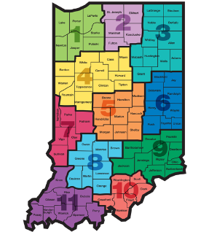
Indiana ADULT EDUCATION
Basic Skills. High School Equivalency. Short-term Training. Certifications and More.
Professional Development
NEXT
STEPS
Moving Forward
2019-2020
Professional Development Next PDF Meeting
December 6, 2019 – 10 a.m. – 3 p.m. – Shepherd Community Center - 4107 E. Washington Street, Indianapolis, IN 46201
February 21, 2020 – 10 a.m. – 3 p.m. – Ivy Tech Fairbanks Building, Room 168, Lawrence Campus, 9301 E. 59th Street, Indianapolis, IN 46216

Slide 53

Indiana ADULT EDUCATION
Basic Skills. High School Equivalency. Short-term Training. Certifications and More.
New
Workforce Initiative Coordinator
for Adult Education
Roy Melton
rmelton@dwd.in.gov
765.413.2216

Slide 54

program is open to anyone age 16 or older who is not attending a high school. It helps people prepare for the equivalency test, earn workforce
certification and even learn English as a second language.
“It’s really all about getting people into career training and employment,” said Robert Moore, director of the program.
The program serves about 500 people each year. Historically, there has been one ceremony in May to recognize their accomplishments. A second
ceremony was added in December this year.
“- 1
Indiana ADULT EDUCATION
Basic Skills. High School Equivalency. Short-term Training. Certifications and More.
►Integrated Education & Training
IELCE | Short-term Training | Certifications
LuVennia Oliver | A.K. Smith Career Center
11 IELCE certifications and 219 IET certifications
4 pending applications
IET Enrollment 3,076 58% goal
IELCE Enrollment 93 16% goal
Still Enrolled 618
Dropped 398 16.19%
Completions 2,060 83.81%
Certifications 1,562 75.83%
“Never give up and have confidence in yourself. We are all intelligent individuals and it's up to us to decide our future.”

Slide 55
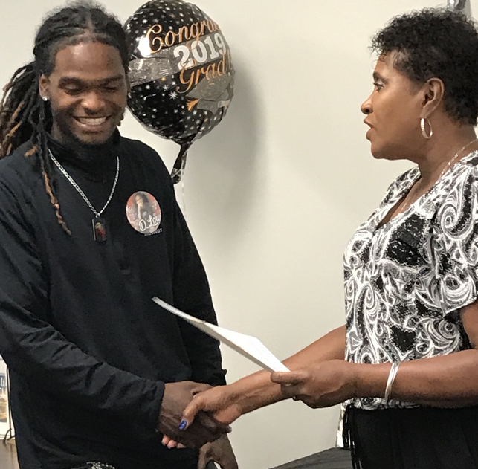
Indiana ADULT EDUCATION
Basic Skills. High School Equivalency. Short-term Training. Certifications and More.
Workforce Education Initiative
The HSE class at Westminster celebrates student achievements.
MSW Warren Township Adult Education
178 WEI certifications
2 pending applications
WEI monthly data report
statewide enrollments –
WEI Enrollments 1,169 19% of the goal
Photo by Natalie Reuter

Slide 56

STATEWIDE | Goal | To-Date
Enrollment | 1,800 | 1,778
Enrollment Rate | --- | 90%
Still Enrolled | --- | 67
Completers | 1,440 | 1511
Completion Rate | 80% | 88.31%
Dropped | --- | 200
Dropped Rate | Below 10% | 11%
Certifications issued | 1,065 | 1222
Certification Rate | 74% | 80.87%
Employment | 640 | 693
Employment Rate | 60% | 45.86%
WorkINdiana
Updates
Statewide
Brin Sisco
Training and System Administrator
Department Of Workforce Development
10 N. Senate Avenue
Indianapolis, IN 46204
317.234.4278 BSisco@dwd.in.gov

Slide 57
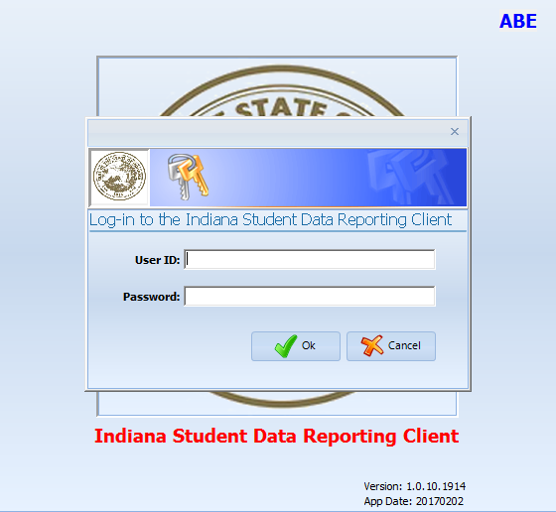
program is open to anyone age 16 or older who is not attending a high school. It helps people prepare for the equivalency test, earn workforce
certification and even learn English as a second language.
“It’s really all about getting people into career training and employment,” said Robert Moore, director of the program.
The program serves about 500 people each year. Historically, there has been one ceremony in May to recognize their accomplishments. A second
ceremony was added in December this year.
“- 1
InTERS
ADULT EDUCATION UPDATES, TRAININGS
Matt Crites
mcrites@dwd.in.gov
Brin Sisco
bsisco@dwd.in.gov

Slide 58
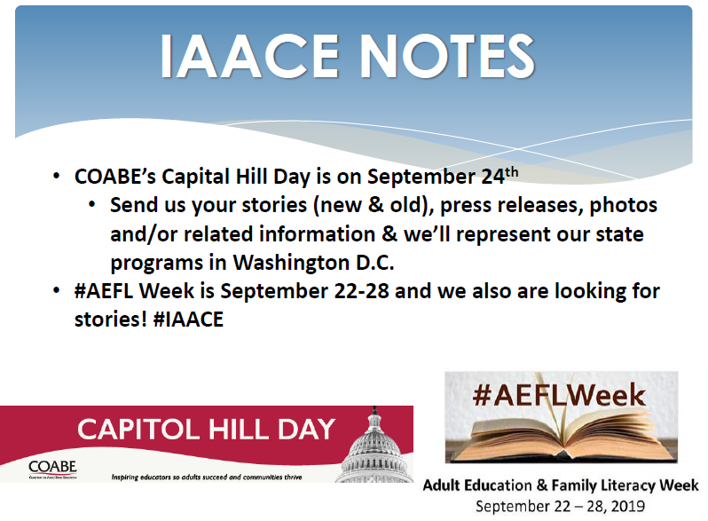
program is open to anyone age 16 or older who is not attending a high school. It helps people prepare for the equivalency test, earn workforce
certification and even learn English as a second language.
“It’s really all about getting people into career training and employment,” said Robert Moore, director of the program.
The program serves about 500 people each year. Historically, there has been one ceremony in May to recognize their accomplishments. A second
ceremony was added in December this year.
“- 1

Slide 59
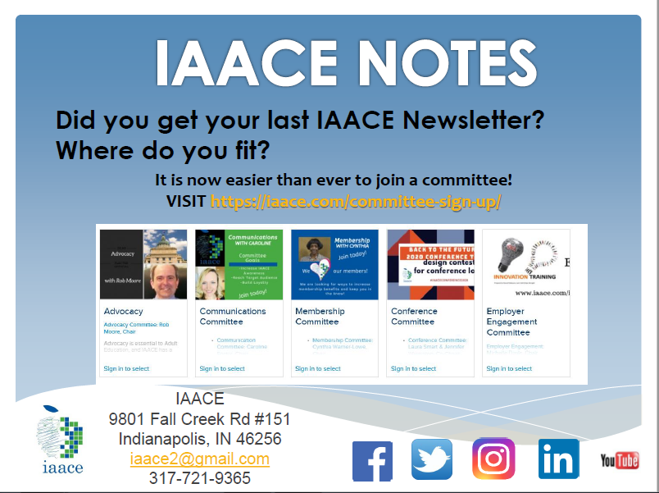
program is open to anyone age 16 or older who is not attending a high school. It helps people prepare for the equivalency test, earn workforce
certification and even learn English as a second language.
“It’s really all about getting people into career training and employment,” said Robert Moore, director of the program.
The program serves about 500 people each year. Historically, there has been one ceremony in May to recognize their accomplishments. A second
ceremony was added in December this year.
“- 1

Slide 60
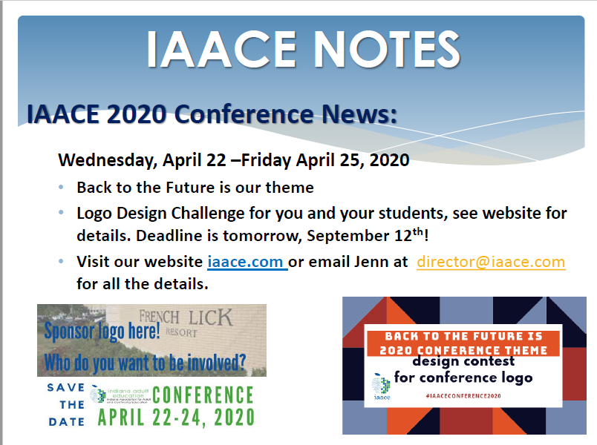
program is open to anyone age 16 or older who is not attending a high school. It helps people prepare for the equivalency test, earn workforce
certification and even learn English as a second language.
“It’s really all about getting people into career training and employment,” said Robert Moore, director of the program.
The program serves about 500 people each year. Historically, there has been one ceremony in May to recognize their accomplishments. A second
ceremony was added in December this year.
“- 1

Slide 61
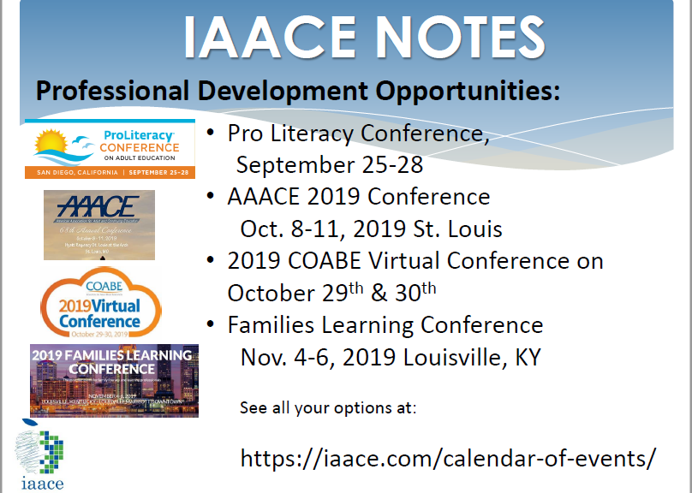
program is open to anyone age 16 or older who is not attending a high school. It helps people prepare for the equivalency test, earn workforce
certification and even learn English as a second language.
“It’s really all about getting people into career training and employment,” said Robert Moore, director of the program.
The program serves about 500 people each year. Historically, there has been one ceremony in May to recognize their accomplishments. A second
ceremony was added in December this year.
“- 1

Slide 62
program is open to anyone age 16 or older who is not attending a high school. It helps people prepare for the equivalency test, earn workforce
certification and even learn English as a second language.
“It’s really all about getting people into career training and employment,” said Robert Moore, director of the program.
The program serves about 500 people each year. Historically, there has been one ceremony in May to recognize their accomplishments. A second
ceremony was added in December this year.
“- 1
Connecting & Engaging.
It’s What We Do!
Next Adult Education & Workforce Development Statewide Webinar
10.9.19
10 to 11:30 a.m. ET

